Slide 1
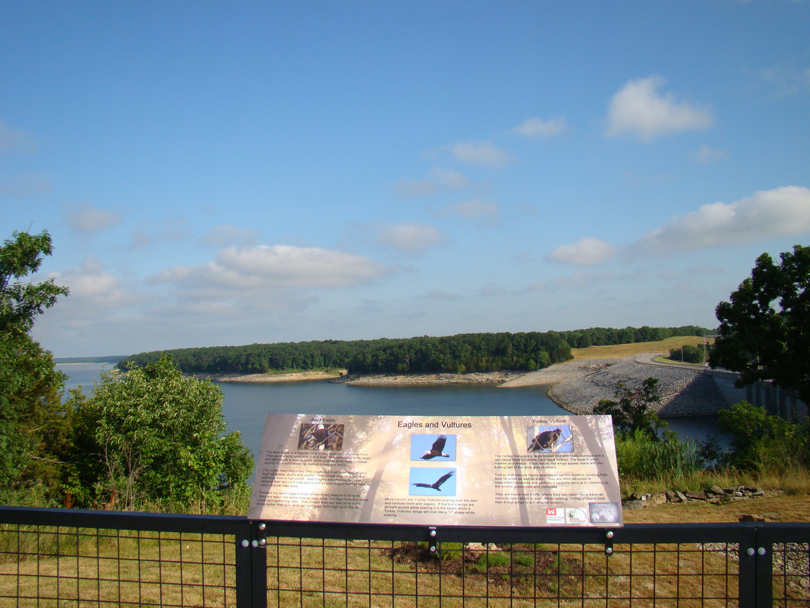
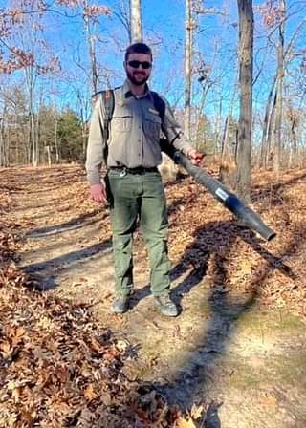
Begin Your Career as a Civilian Employee Now!
Join the St. Louis District, U.S. Army Corps of Engineers (USACE), Mark Twain Lake
USACE Vision
Job Information
Engineering solutions for our Nation’s toughest challenges.
1
Occupation Series:
*Park Ranger (0025 Series)
Pay:
* Park Ranger (temporary), starting hourly wage of $15.30 (GS-02) to $15.92 (GS-04) per hour
* Park Ranger (Term- 13 months), starting annual salary of $36,118 (GS-05)
Location:
Mark Twain Lake, 20642 Highway J
Mark Twain Lake, Missouri 63456
Competencies Required: Leadership, teamwork, and communication.
For Additional Information:
Contact Tim Eash at 573-735-4097
To Apply
Provide a copy of your resume and unofficial transcript to Tim Eash: timothy.j.eash@usace.army.mil
Please note: This announcement will close on April 22, 2022. If resumes are not received from enough qualified applicants to fill all positions by that date, the announcement period may be extended. Call the phone number above for additional information.
Human Resources POC: Michael Dawkins,
HR Specialist, 314-331-8442, Michael.B.Dawkins@usace.army.mil
USACE Vision
2
Deliver vital public and military engineering services; partnering in peace and war to strengthen our Nation’s security, energize the economy and reduce risks from disasters.
3
4
Operations Division, USACE- St. Louis, Mark Twain Lake
We have a variety of entry-level, temporary (3 to 6 month) Park Ranger
positions, and longer, Term (13 months) Park Ranger positions open for
those with related experience. Term positions may extend beyond 13
months if budget permits and employee is performing satisfactorily, based
on performance ratings.
The type of work can include all aspects of project operations such as
natural resources, recreation and flood risk management. Work activities
include one, or more, of the following:
Recreation and park administration
Flood Risk Management
Environmental stewardship, soil and water conservation
Fisheries and wildlife management
Public Relations
Historic property management and protection
Visitor assistance, public safety, and education

Slide 2
Park Ranger Job Duties
May include the following*:
Serves as a uniformed ranger with designation as an Officer of the United States for the purpose of enforcing pertinent regulations and laws.
Patrols the project areas, operating a boat or motor vehicle, to observe and check compliance with regulatory and administrative requirements.
Makes various personal contacts to explain policies and regulations to project visitors and to guide public recreation users on natural resources values and responsibility for land stewardship.
Plans, promotes, and presents visitor information programs, such as environmental awareness programs, water safety programs, wildlife observation, and volunteer opportunities.
Long and short-range planning, administration, coordination and management of various project activities (i.e., of environmental stewardship, recreation, park administration, public relations, visitor assistance, and public safety).
Plans and executes natural resources analyses pertaining to forest management (including disease and insect control), wildlife management, natural, cultural, and historical resource interpretation, and public safety hazards.
Participates in conservation, preservation, restoration and use of project natural and cultural resources.
Prescribes and implements resource management actions that promote biodiversity and native species re-establishment.
Evaluates proposed real estate and shoreline uses for environmental, cultural, and public use impacts and performs outgrant and shoreline use inspections.
Assist with park maintenance activities.
Conducts contract inspections under the project’s quality assurance program ensuring contractor’s meet contract specifications related to service and light construction work.
Assist with project's environmental compliance program.
Collects and records piezometer/weir/outfall information and reports to District Office.
Inspects dam and appurtenant structures and equipment using standard inspection checklists supporting Flood Risk Management requirements.
*Actual duties will be dependent on which section (Visitor Assistance, Interpretive Services and Outreach, Natural Resources and Facilities Management) one is assigned.

Slide 3
Park Ranger Qualifications
About the Position
Temporary positions will be filled at the GS-02, GS-03 or GS-04 level. These are considered entry level, training positions. As appropriate time in grade requirements are achieved, promotion up to the GS-04 level is possible, if performance is satisfactory.
Term positions will be filled at the GS-05.
Temporary Positions (Up to six (6) months per year):
GS-02: Education: High school graduation or equivalent (note: You must attach a copy of your transcripts) and six (6) months of general work experience.
GS-03:
Education: 1 year above high school with 6 semester hours of related course work (note: You must attach a copy of your transcripts) or six (6) months of general experience or three (3) months of specialized experience.
GS-04:
Education: 2 years above high school with 12 semester hours of related course work (note: You must attach a copy of your transcripts) or six (6) months of general experience or six (6) months of specialized experience.
Term Positions (13 months appointment- extensions possible if performance AND budget allow):
GS-05: Education: 4-year course of study above high school leading to a bachelor's degree with 24 semester hours of related course work such as biological sciences, agriculture, natural resource management, chemistry, or related disciplines appropriate to the position or at least one year of specialized experience equivalent to the GS-05 grade level in the Federal service which includes providing organizational information to local, state and Federal agencies and/or the visiting public; and participating in programs designed to protect and further enhance fish, wildlife, vegetative and/or water resources. (Note: You must attach a copy of your transcripts.) OR Combination of education and experience: Courses equivalent to a major, as shown above, plus appropriate experience or additional education. (Note: You must attach a copy of your transcripts.) OR Combination of Education and Experience: A combination of education and experience may be used to qualify for this position as long as the computed percentage of the requirements is at least 100%. To compute the percentage of the requirements, divide your total months of experience by 12. Then divide the total number of completed graduate semester hours (or equivalent) beyond the second year (total graduate semester hours minus 36) by 18. Add the two percentages.

Slide 4
Conditions of Employment
Appointment may be subject to a suitability or fitness determination, as determined by a completed background investigation.
A valid state-issued driver’s license is required for this position.
This is a uniformed position and employee will be expected to maintain all uniform and personal appearance standards per U.S. Army Corps of Engineers regulations.
Must be able to maintain Corps of Engineers certification for Citation Authority.
Must be able to maintain required Corps of Engineers certification for operation of the motorboat.
This position is covered by the Civilian Drug Testing Program. Pre-employment and random drug testing is required. A DA 5019 is required for verification of understanding that this is a drug testing position.
This position will require the incumbent to work nights, weekends, and holidays, as necessary.

