Slide 1
Tools Tested for Outdoor Recreation Environmental Education & Stewardship
Laura Baird, M.S. Student
Logan Park, Ph.D.
Notes:
Field trip to Great Smoky Mountains National Park
30 elementary school students, 3 chaperones
What is happening?
Nice, orderly line/engaged?
Chaos?
How many granola bar wrappers littered?
This scene is our inspiration

Slide 2
For the first time ever,
KAB is going social at
National Conference!
Be part of the conference conversation and
use #KAB2014 on
Facebook, Twitter &
Instagram.

Slide 3
Helping Us Help Your Next Project
April Buther Wennerstrom, Stacey Rice, Grace Keegan Massinello: Keep America Beautiful
Ben Lawhon: Leave No Trace International
Jen Randolph: Girl Scouts of Southern Illinois
Dan King, Jeremy Culpepper, Brian Joseph: Camp Ondessonk
Camps Ondessonk & Cedar Point, Crab Orchard Natl. Wildlife Ref.
Kelsey Ernst and Dusty Copple: research assistants
Notes:
Duplicated at the end to reiterate

Slide 4
In The Room Today
You, but who are you?
Logan Park – Logan.Park@siu.edu
Laura Baird – Laura.E.Baird@siu.edu
Notes:
Important to us to shape this time to be valuable to you
I’m introducing some useful tools,
Laura’s starring with a useful example

Slide 5
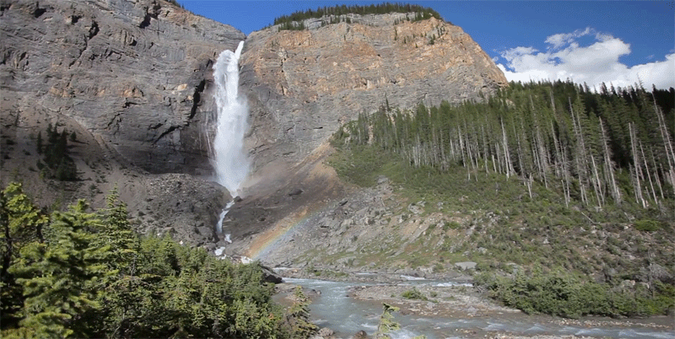
America’s resources
Notes:
Logan Park
Recreation ecologist
The resource

Slide 6
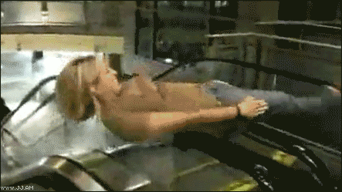
And The People
[Some of] America’s people
Notes:
The people

Slide 7
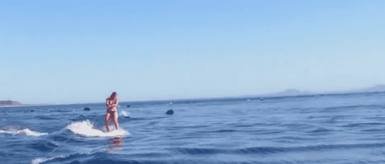
Resources and People Interact
Sometimes positively!
Notes:
Predictable ways
Sometimes positive ways

Slide 8
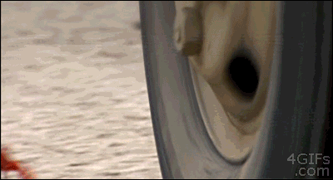
…And Sometimes:
Sometimes positively!
Notes:
Predictable ways
Sometimes positive ways

Slide 9
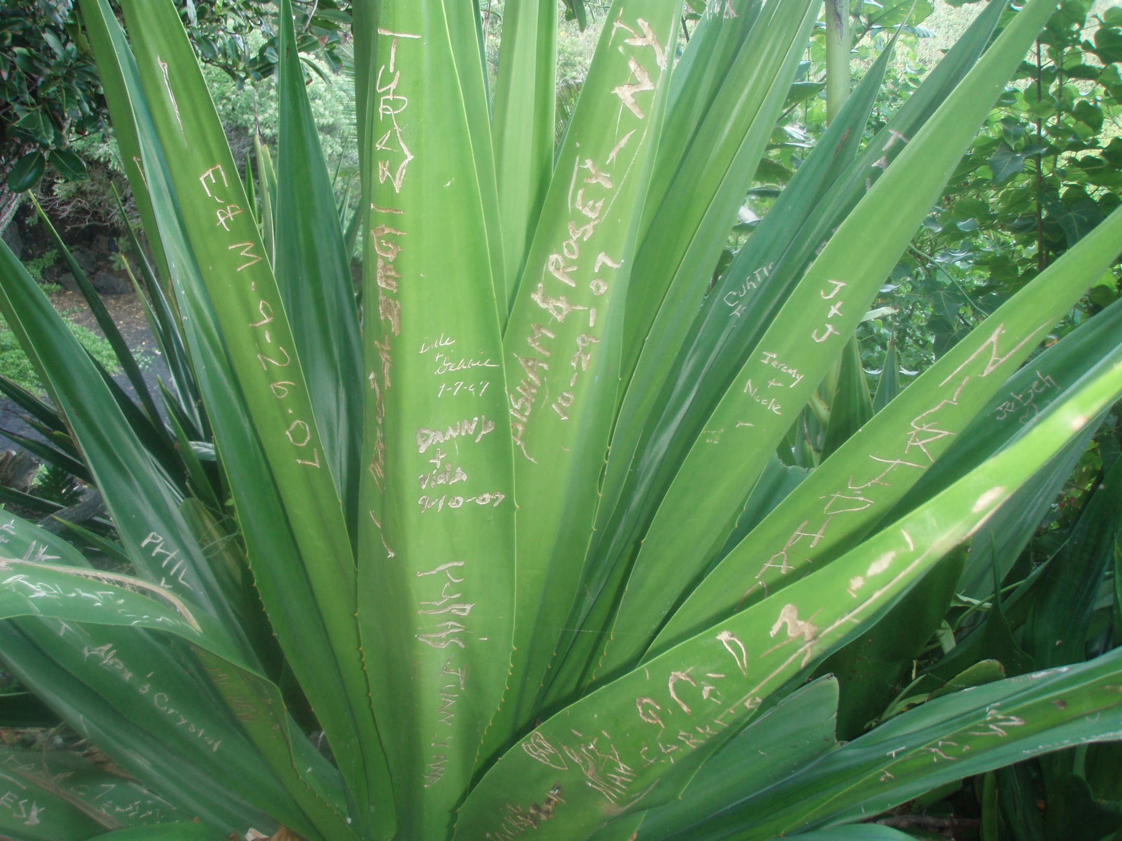

Slide 10
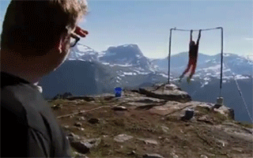
Individuals Sometimes “Leave A Trace”

Slide 11
Stories, Not Statistics
But what about crazy-sized stats?
Billions of visits annually
Notes:
We have to deal constructively

Slide 12
Your Village Is Distinctive
Federal, international-scale research
Every application is local
Skip trial-and-error
Fit these tools to your needs
Notes:
Researchers → $ millions $ → tools for you

Slide 13
Useful Work By Smart People
Stages of Moral Development
  (Kohlberg, 1971; Murphy and Gilligan, 1977)

Slide 14
Useful Work By Smart People
Stages of Moral Development
“Post-Conventional”
“Conventional”
??
“Preconventional”
Likely

Slide 15
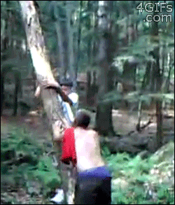
Conventional: Perceived Peer Opinion
NOT KEEPING
AMERICA
BEAUTIFUL

Slide 16
Useful Work By Smart People
Stages of Moral Development
Direct vs. indirect behavior influencers
  (Gramann et al. 1992; Manning 1999)

Slide 17
Useful Work By Smart People
Stages of Moral Development
Direct vs. indirect behavior influencers
Information/ Education
Decision
Behavior
Direct Tactics

Slide 18
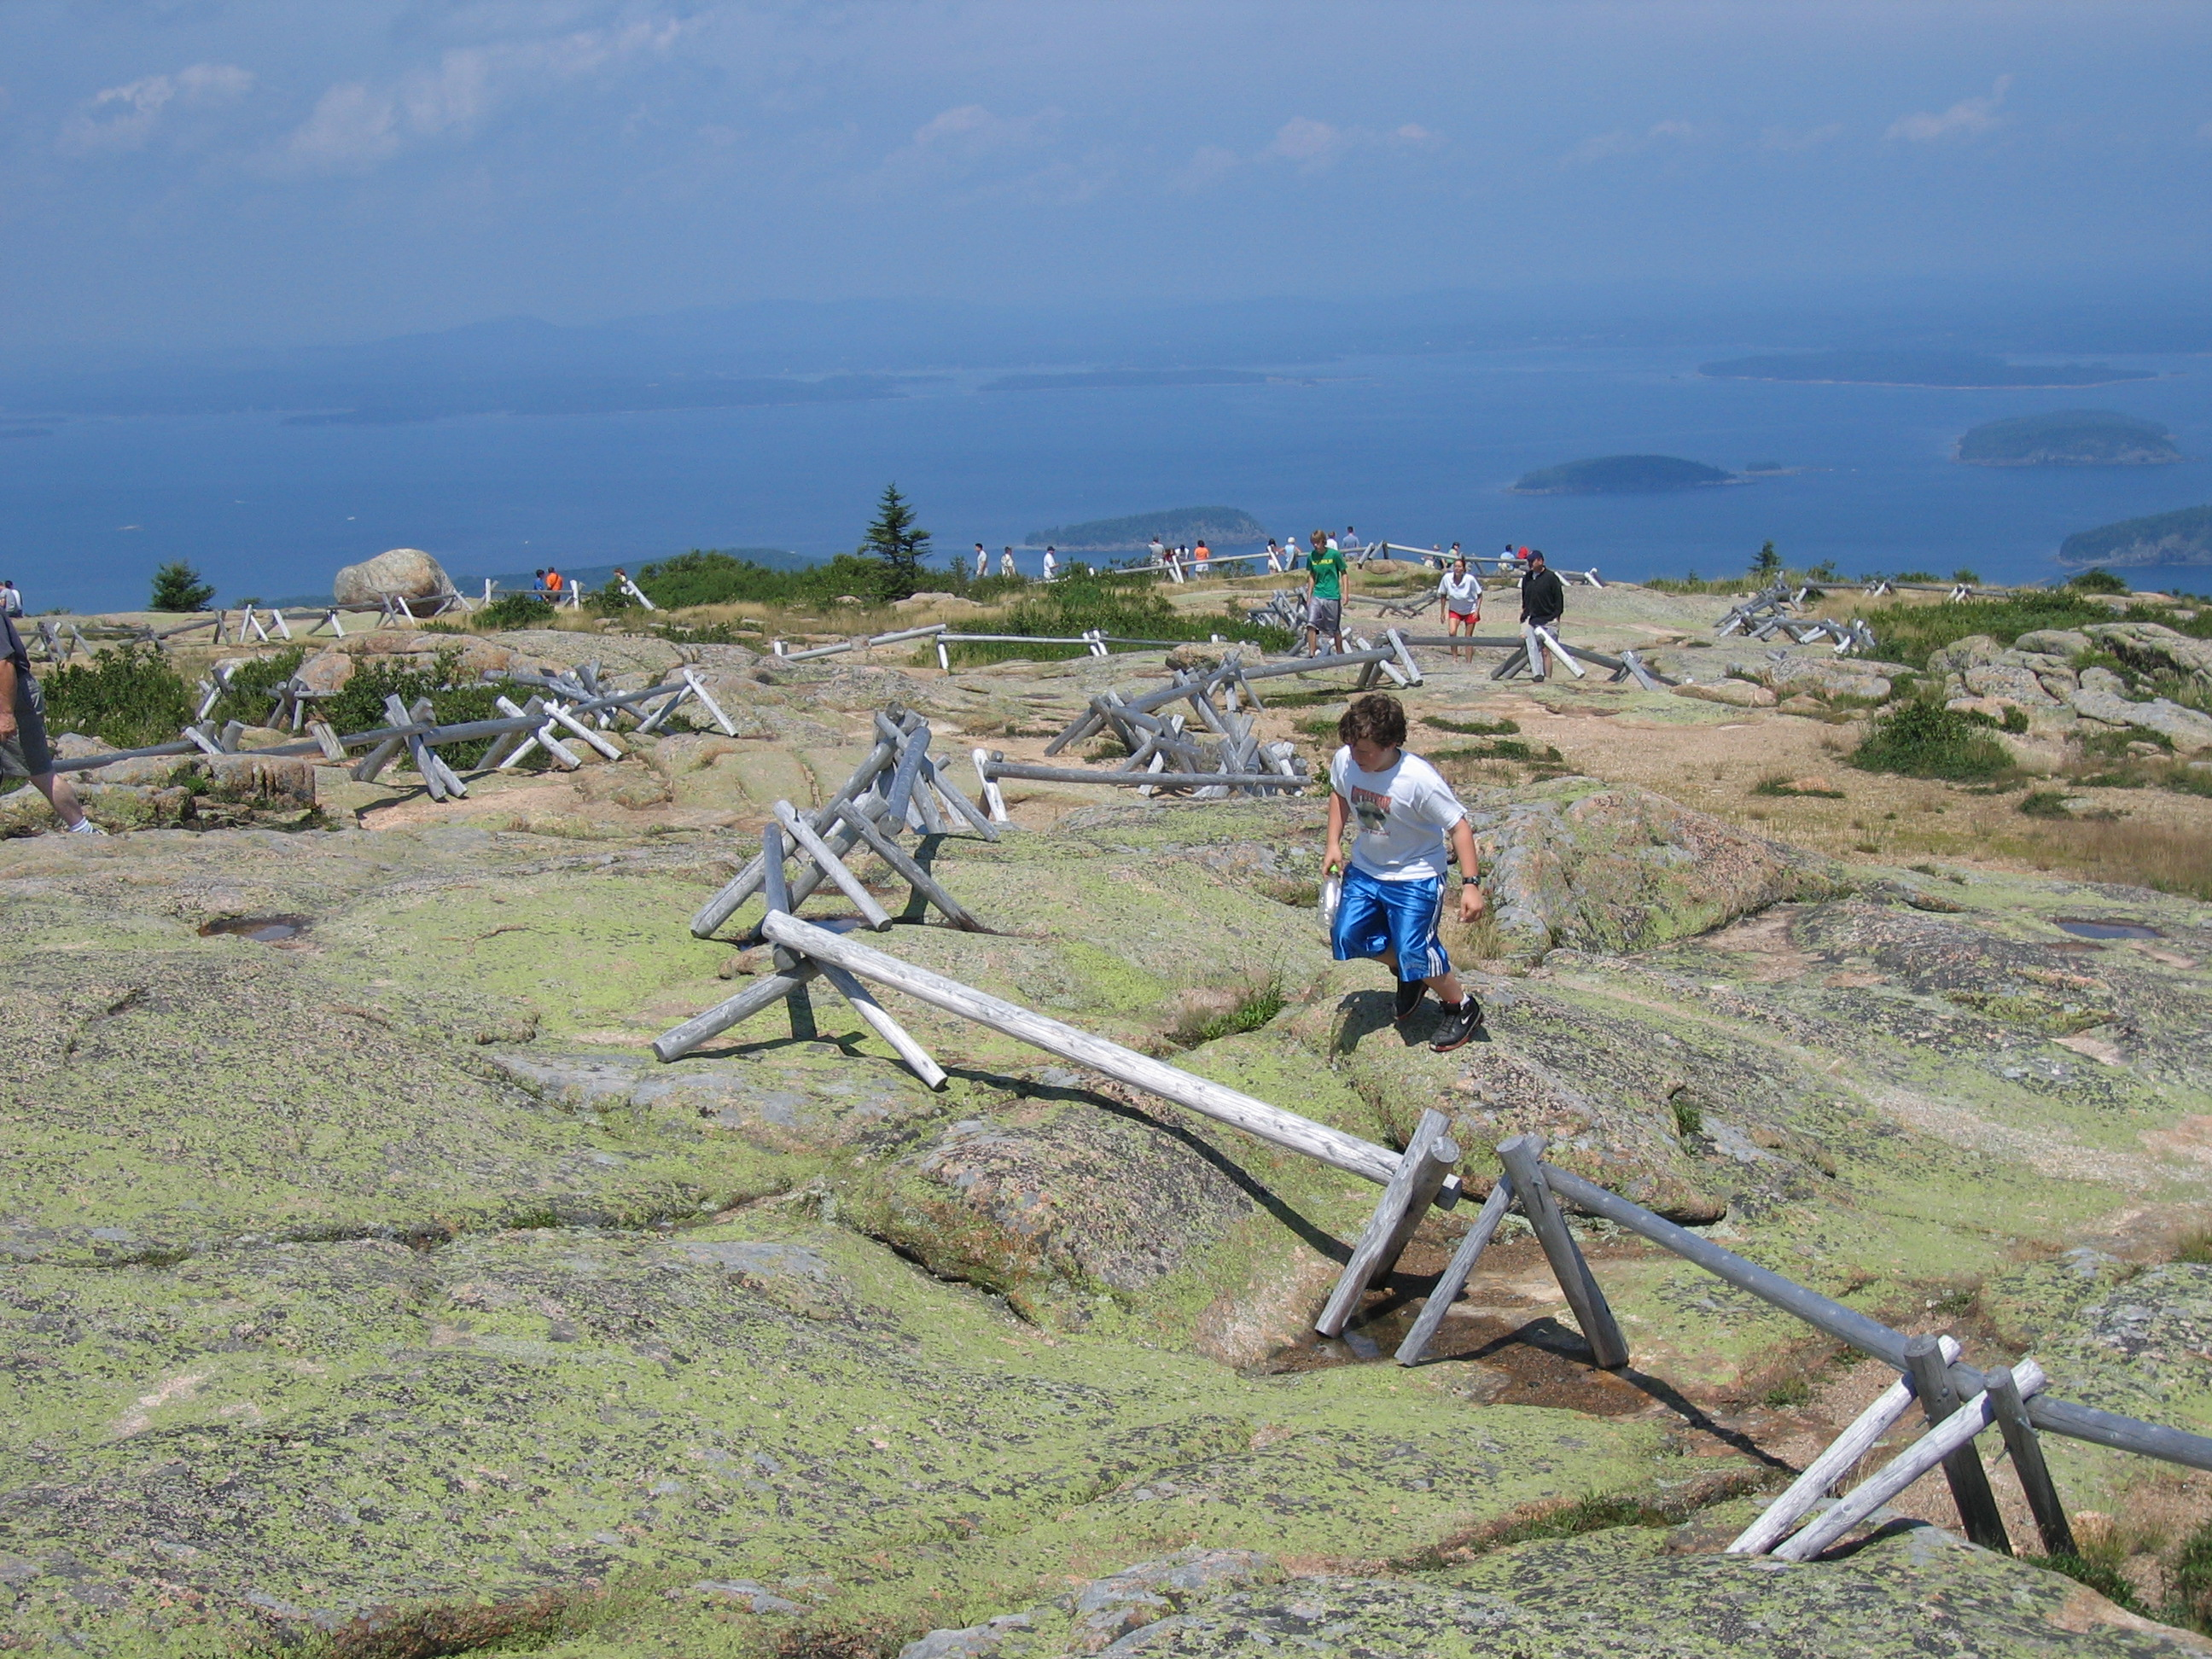
Site Management

Slide 19
Site Management

Slide 20
Useful Work By Smart People
Stages of Moral Development
Direct vs. indirect behavior influencers
Elaboration Likelihood Model of Persuasion
  (Petty & Cacioppo, 1981)

Slide 21
Useful Work By Smart People
Stages of Moral Development
Direct vs. indirect behavior influencers
Elaboration Likelihood Model of Persuasion
Message Content
Message Sender
Persuasion

Slide 22
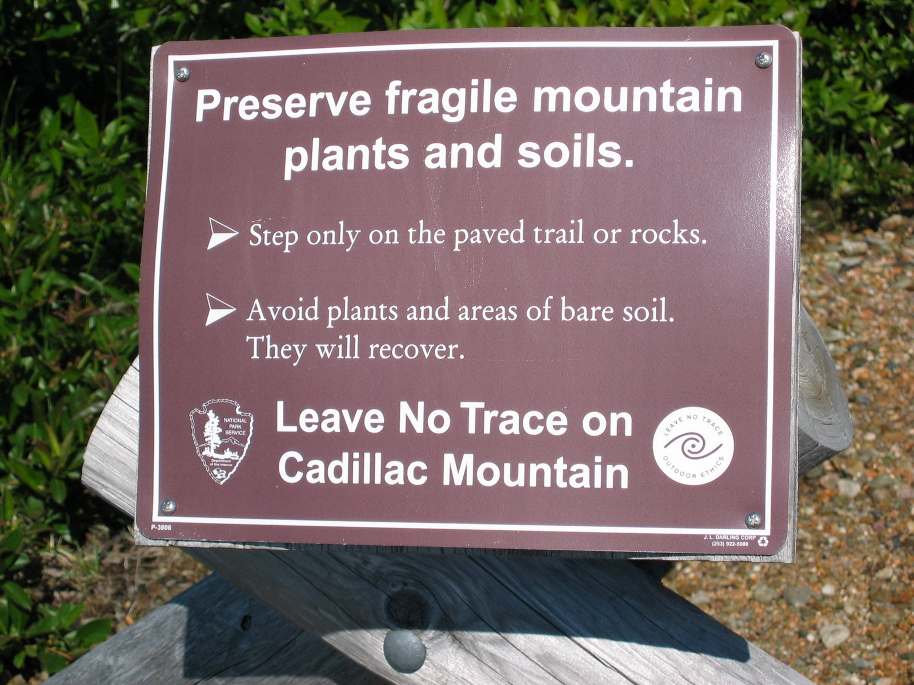
Central vs. Peripheral Persuasion Route
Notes:
Duplicated at the end to reiterate

Slide 23
Useful Work By Smart People
Stages of Moral Development
Direct vs. indirect behavior influencers
Elaboration Likelihood Model of Persuasion
Theory of Planned Behavior
  (Ajzen, 2011; 1991)

Slide 24
How You Plan Behavior
Behavioral Beliefs
Attitude Toward the Behavior
Intention
Behavior
Normative Beliefs
Subjective Norms
Control Beliefs
Perceived Behavioral Control
Actual Behavioral Control

Slide 25
Useful Work By Smart People
Stages of Moral Development
Direct vs. indirect behavior influencers
Elaboration Likelihood Model of Persuasion
Theory of Planned Behavior
Match depreciative behavior motivation to management tactics
  (Hendee, 1990; Roggenbuck, 1992)

Slide 26
Match Your Planned Response With Reason
Unavoidable
Careless
Uninformed
Low
Med
High
Unskilled

Slide 27
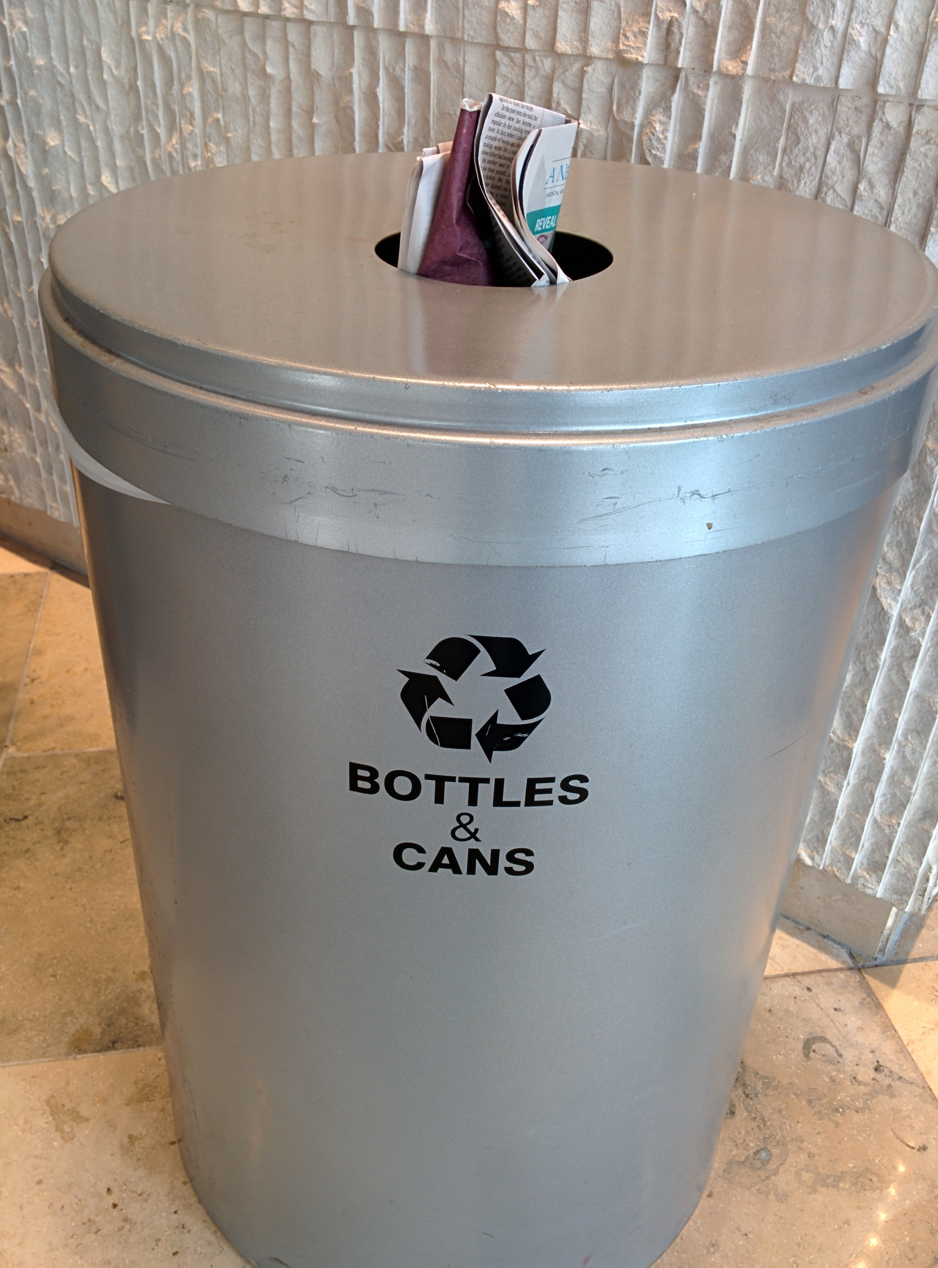
Laura Baird: Application
Notes:
SOLVE PREVENT UPLIFT

Slide 28
Background
Marine Science → Forestry
Fourfold interests of children (Dewey, 1899):
  Conversation
  Finding out things
  Making things
  Artistic expression
Field trips and summer camps
Benefits of pre-visit preparation

Slide 29
Key Questions
How do we best improve pro-resource behaviors and attitudes in kids?
How do we do this while keeping our project:
low-cost?
easily replicable?
easily administered?
Notes:
The key questions we asked when we embarked on this project were how do we best improve pro-resource behaviors and attitudes in kids? as well as How do we do this while keeping our project low-cost, easily replicable, and easily administered? We wanted to use our results in a real program that many future groups of kids and teachers can use together. What is the point of program development if the end result is unrealistic?

Slide 30
What We Did
Phase 1 (Fall ‘12 - Spring ‘13):
Create program content to NAAEE standards
Form partnerships
Pilot materials for mechanics and flow
Modify materials
Notes:
This project was completed in three phases. The first involved developing the program materials, using the North American Association for Environmental Education, the NAAE’s, Guidelines for Excellence for Nonformal EE Programs. These guidelines are a valuable tool for anyone looking to develop a new EE program, and can be found on NAAEE’s website. We sought out and formed partnerships with the local National Wildlife Refuge, the Girl Scouts of Southern Illinois, and the Leave No Trace Center for Outdoor Ethics. Once the partnerships were in place, we piloted the games, survey, and journal with fourth grade students from a local school, but because resources were scarce, were unable to pilot the bracelet until the first week of the study. I’ll talk a little more about that first week in a bit. We modified the survey, journal and games to make them flow more smoothly, and then moved into the second phase of our project. Before I go into the project implementation, we’d like to share some details about the program materials.

Slide 31
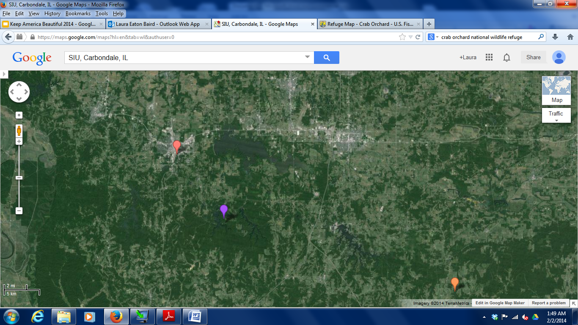
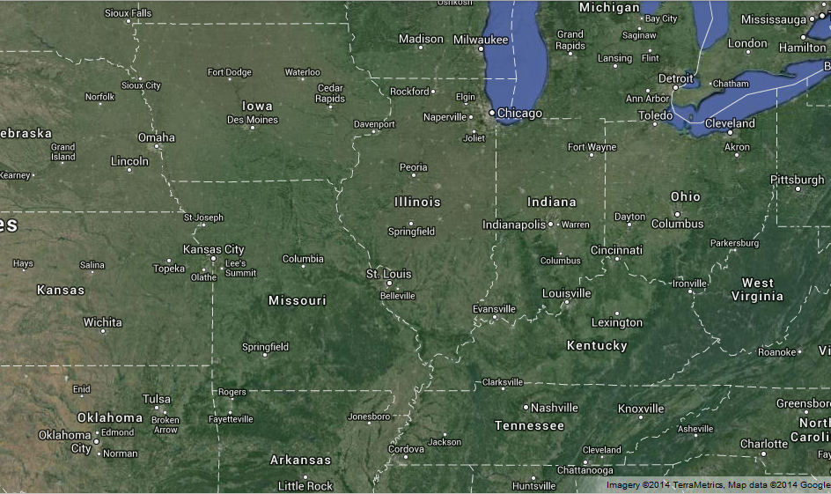
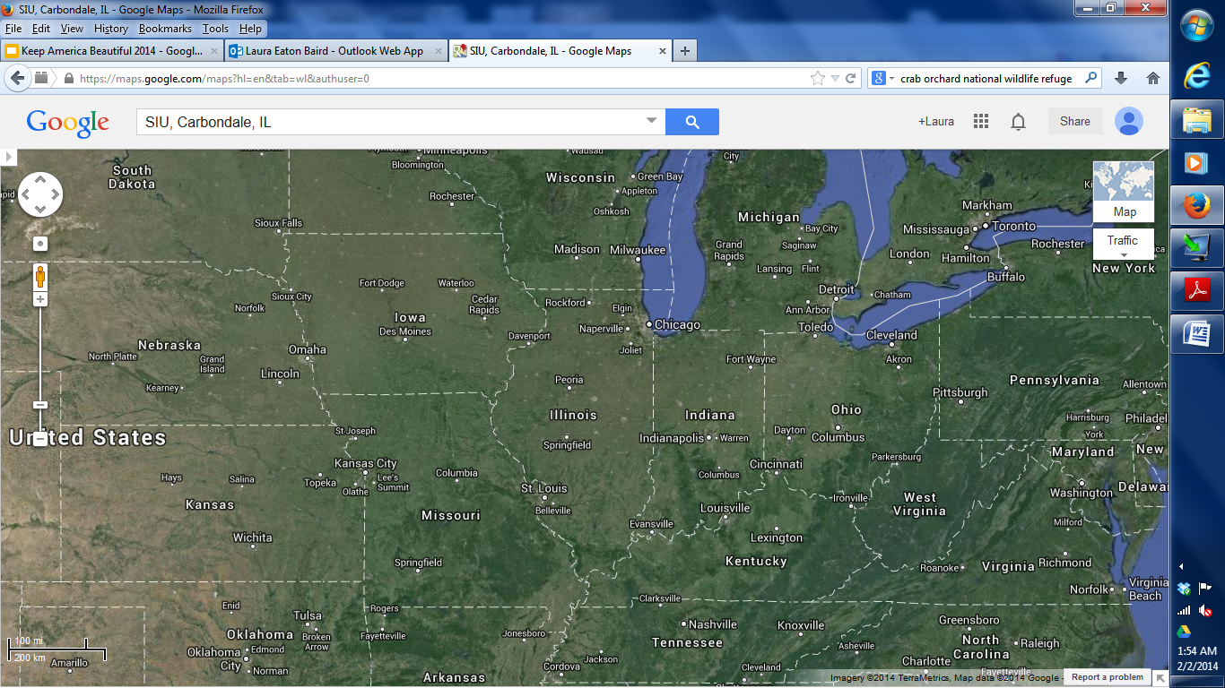
What We Did: Study Sites
Southern Illinois University Carbondale
Camp Cedar Point
Camp Cedar Point
Camp Ondessonk
Notes:
We conducted our research at Camp Cedar Point, within Crab Orchard National Wildlife Refuge in Makanda, Illinois and at Camp Ondessonk in Ozark, Illinois.

Slide 32
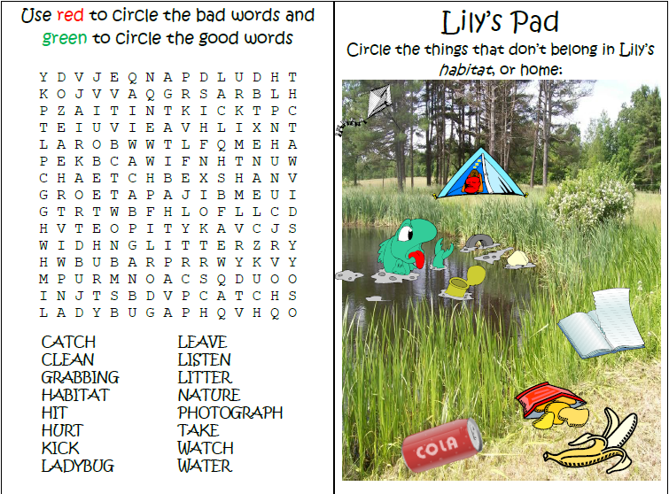
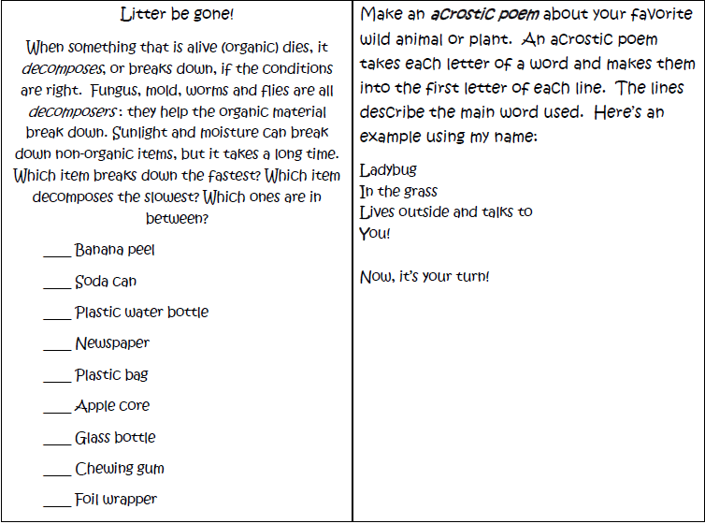
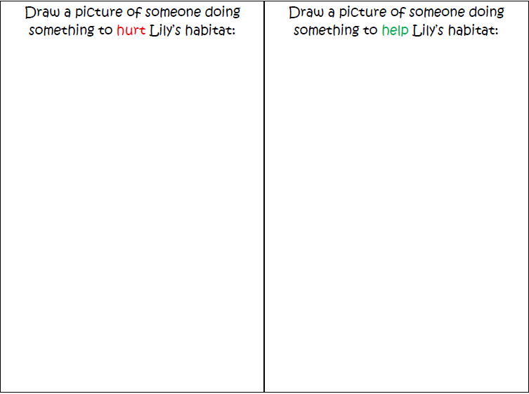
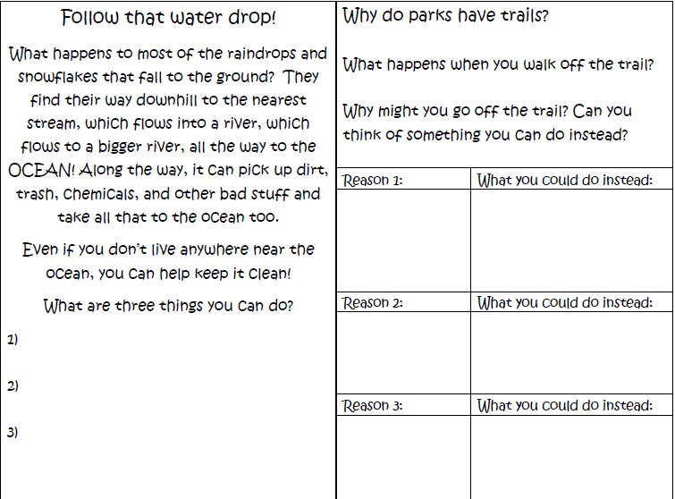
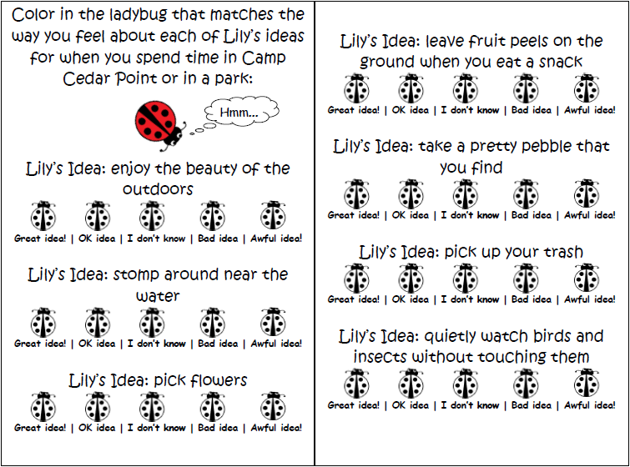
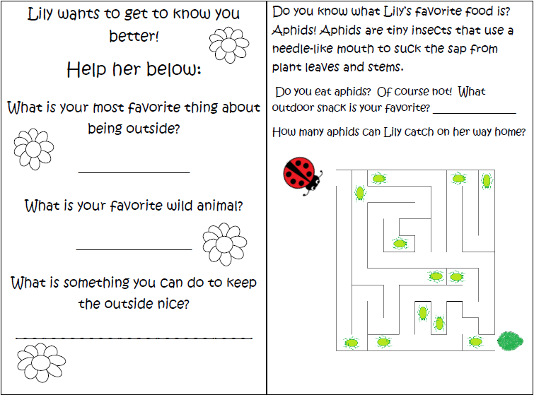
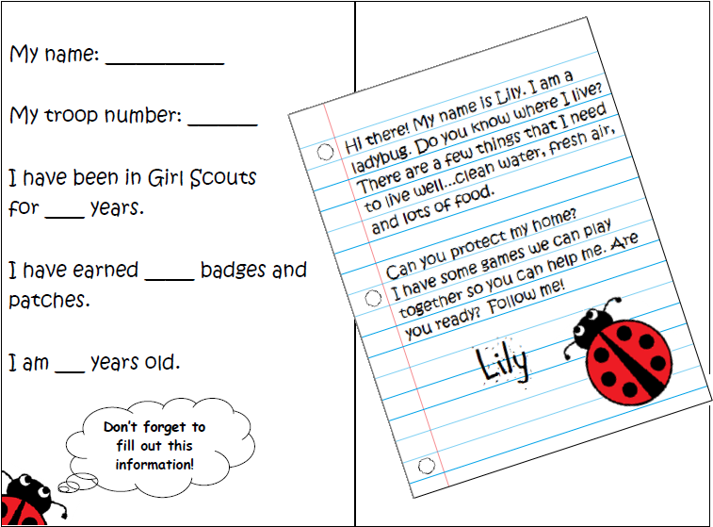
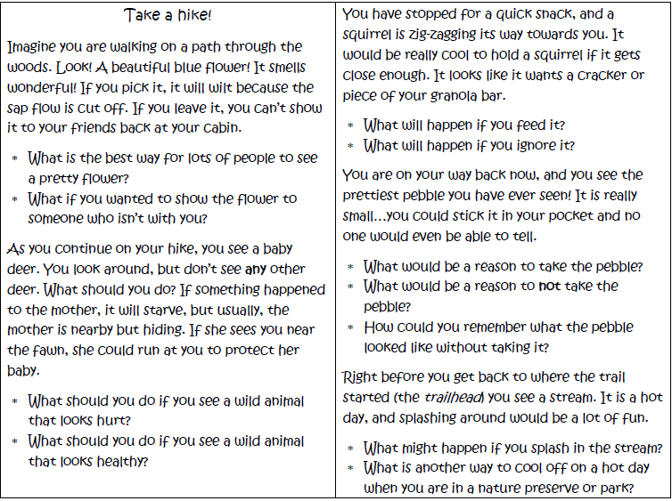



What We Did: The Journal
Notes:
Meet Lily, the official mascot for our project. She can be found throughout the journal’s pages. Since one of our main goals was program assessment, the first pages are dedicated to collecting some basic demographic information about the camper: age, years she has been a scout, troop number, etc. I also asked the campers to name something that they can do to keep the outside nice, and what they like about being outside. I explained at the outset of the session that we were talking about how to act when you are outdoors at a park or camp, because you might act differently than you would when playing in your own back yard. Then, I asked them what they thought about Lily’s ideas so I could measure their attitudes towards six specific actions. I used the same survey at the end of the session, and then at the end of camp to see if there was any attitude change after the program and after a week of camp. Inside the rest of the journal are pages of activities combining drawing, writing, critical thinking, games, and even poetry. I wanted to have something for everyone. The last activity is a discussion where I led the campers through a hypothetical hike, asking questions like, “What is the best way for lots of people to see a pretty flower?” I got answers like, taking a picture, drawing it, or even digging it up and planting it at home (which wasn’t what I was going for, but they were definitely thinking outside the box).

Slide 33
What We Did: The Bracelet
Personalized bracelets to wear on the hike:
Foam stickers vs. permanent markers
Kits to assemble vs. making them in-session
Notes:
The first week of camp was unfortunately the first time I was able to test the bracelet-making activity with a large group of campers. I had only allotted an hour for the journal, bracelet and games and was running dreadfully behind, so I had put together the pre-cut craft foam strips, elastic string, and foam stickers into baggies so the campers could put them together while waiting for showers or during their rest time. I did not, however, stress to the counselors how important the bracelets were, so most of the campers showed up without bracelets. The ones that had bracelets on kept losing the foam stickers off of the bracelets, so that the only week out of seven that I saw instances of littering on the hikes was that first week, from all the foam stickers. I re-designed the craft so that the base foam was white and, during the second week, the girls used permanent markers to decorate them with a message they learned that day, and I collected them at the end of the program and handed them back out at the beginning of the hike the next day.

Slide 34
What We Did: The Games
Campers played three interactive games:
Catch a Running Squirrel (Don’t chase wildlife)
Follow that Waterdrop (Don’t litter/pollute waterways)
Stay on the Trail (Stay on the Trail)
Notes:
We also made three games to emphasize three of the messages discussed in the journal activities. We will demonstrate them for you at the end of the presentation (I will need some help), but here is a short description of each. In Catch a Running Squirrell, the three people who are “It” are actually the targets, assigned the roles of bird, squirrel, etc. The rest of the campers have 30 seconds to tag those three campers as many times as possible, as long as they don’t each touch the same person twice in a row. After 30 seconds, we stop, and each animal tells how many times they were tagged, followed by three to four more 30 second rounds, with the number of tags usually increasing each round. Eventually, inevitably, the three would just stop running, entirely worn out, very annoyed, and completely empathetic with wildlife.
The second game, Follow that Waterdrop, was a slow-motion Red Rover, where one camper, the waterdrop, would start at the beginning of an imaginary waterway, walking along and picking up other campers (posing as pollution) that tagged the waterdrop as they walked by. Different variations were possible to demonstrate the results of having less pollution in the water, a heavy rainstorm (more waterdrops), or adding a filter at the end.
The third game, Stay on the Trail, split the campers into two teams. They each used a long rope to form a twisty, turny tightrope trail that the other team then had to walk along, like a relay race. This game taught that you needed to pay attention and enjoy your walk so you didn’t fall off the trail.

Slide 35
What We Did
Phase 1: Create, pilot, and modify
Phase 2 (Summer 2013):
Small-group critical thinking workshops
Pre- and post-program evaluation
Observe camper behavior on hikes
Notes:
The second phase was the implementation of the program itself, which had three combinations of the activities. One combination was the journal and the bracelet, one was the journal and the games, and one had all three. We also had a control group that received no program, just a pre- and post-camp survey to control for any effects just being outside for a week might have had. In addition to the program itself, we observed camper behavior on hikes, allowing us to see if behavior was modified by the program as well.

Slide 36
What We Did
Included in the study:
119 Girl Scout campers, 7-10 years old
106 Coed summer campers, 8-10 years old
Sequence during camps:
First full day: Pre-program evaluation, activity completion, post-program evaluation
Second or third full day: behavior observation
Last day of camp: Followup program evaluation
Notes:
On the first full day of each camp, I went through the journals with the campers, and, depending on the week, included the bracelet activity, the games, or both. The campers filled out the survey before and after this part of the week, and then on the second or third day, I went on a hike with the campers and noted behaviors such as going off trail, littering, disturbing wildlife, and so on. On the last day of camp or on the evening before the last day of camp, the campers filled out the same survey so I could test the staying power of what they had learned. This was repeated for five of the seven weeks. On the other two weeks, campers filled out the same survey at the beginning of camp and on the last day. All of this information was coded and entered into the computer.

Slide 37
What We Did
Phase 1: Create, pilot, and modify
Phase 2: Implement and evaluate
Phase 3 (in progress):
Data analysis
Further revision
Scaling up of program materials into “kits”
Dissemination of findings
Notes:
Now, we are in the midst of phase three. After a few minor revisions, the project materials will be scaled up into kits for use by school groups and scouting groups as a pre-visit program before they visit protected natural areas. Officials from the US Forest Service and the Illinois Department of Natural Resources have already expressed interest in expanding and using the kits. We are now sharing what we have found with the public, such as the attendees of this conference. Here is what we have found:

Slide 38
What We’re Finding
Pick up trash

Slide 39
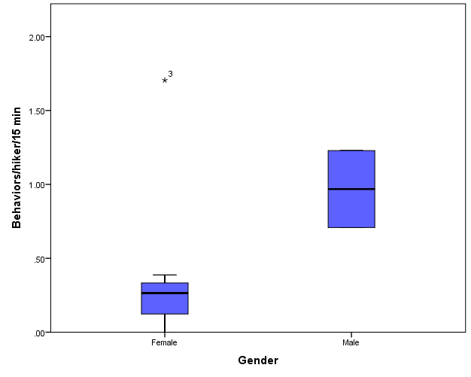
What We’re Finding

Slide 40
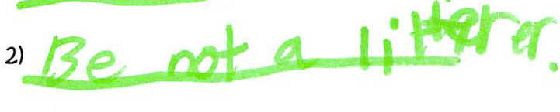
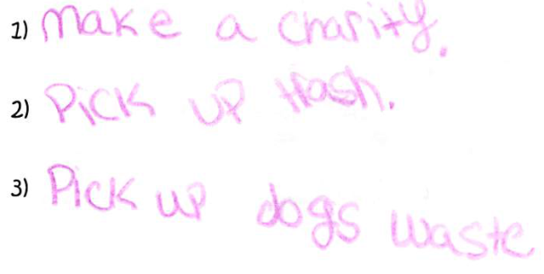
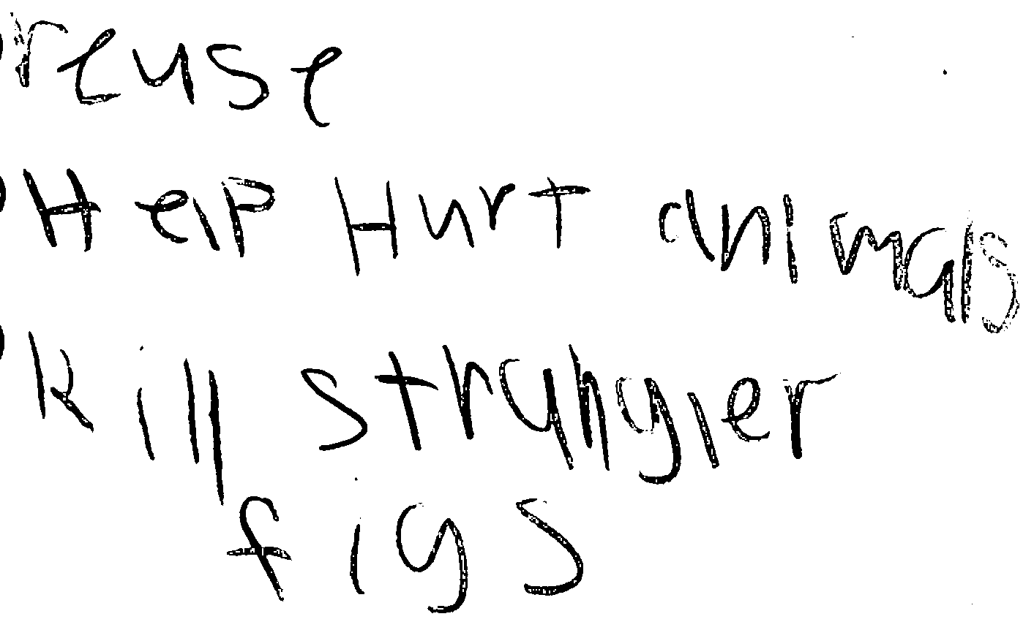


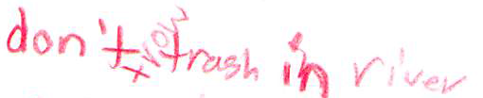
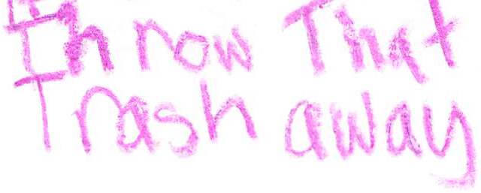
Sample Responses: “What are three things you can do to here in Illinois keep the ocean clean?”

Slide 41
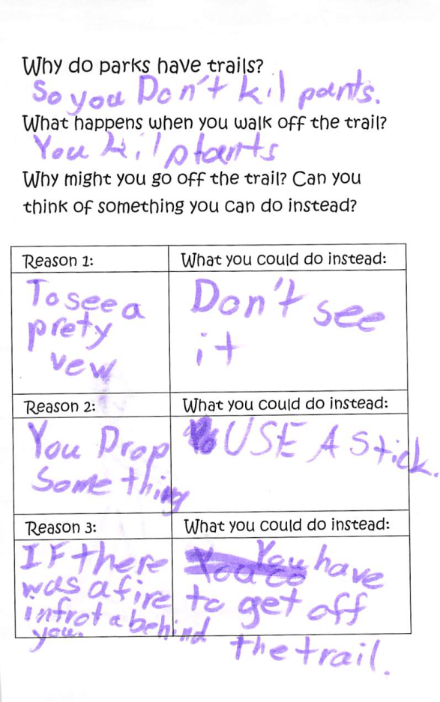
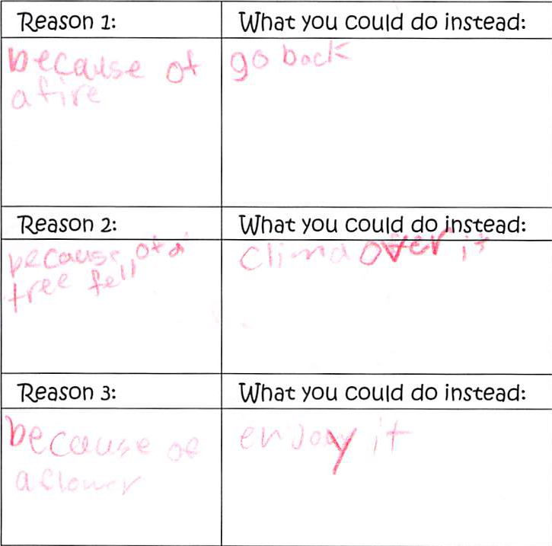
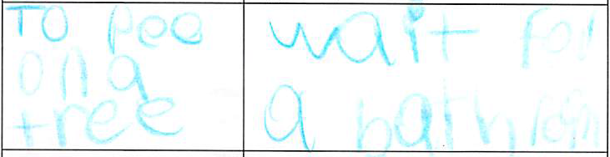
Sample Responses: Staying on the Trail

Slide 42
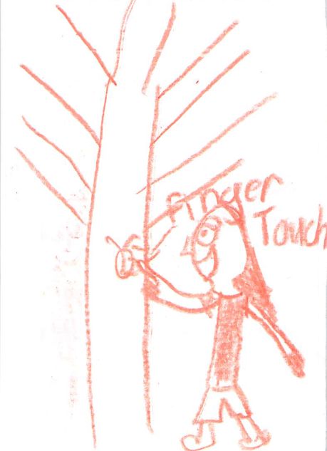
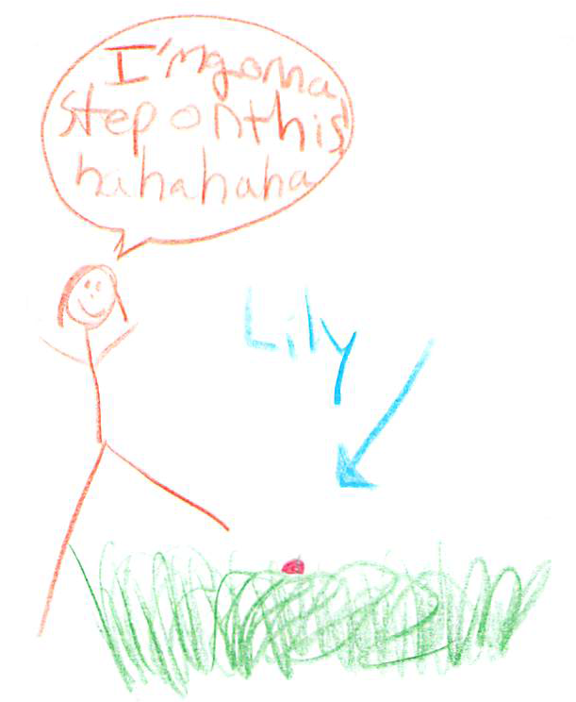
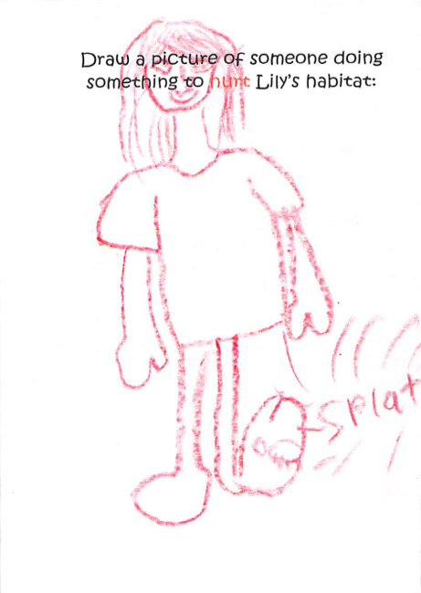
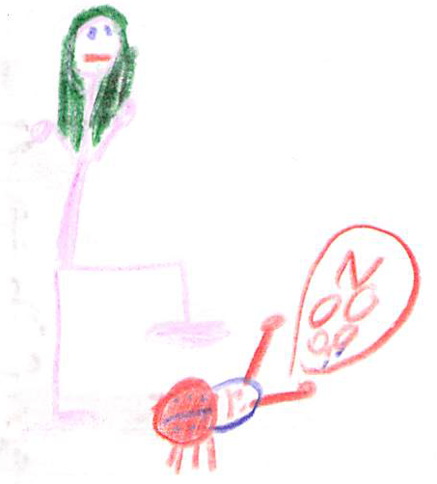
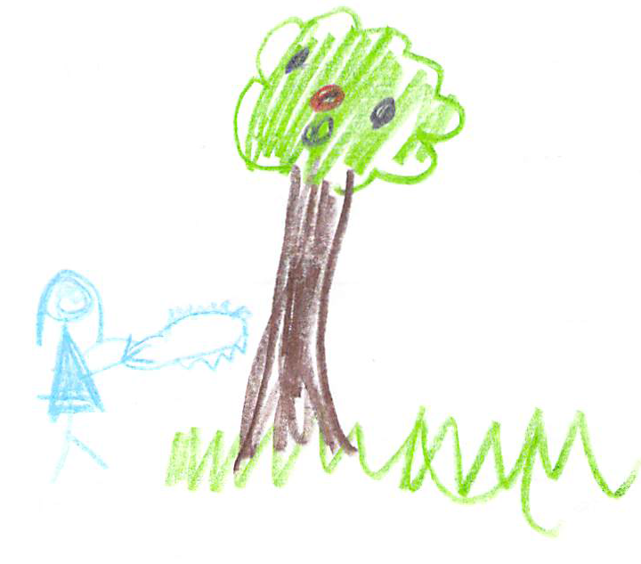
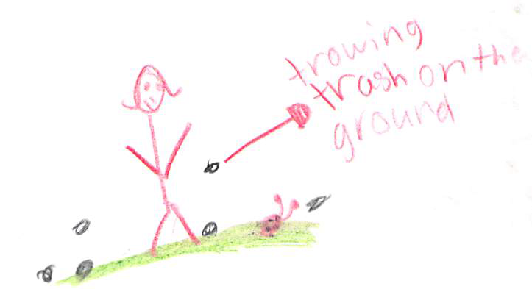
Sample Responses: “Draw a picture of someone doing something to HURT Lily’s habitat:”
133

Slide 43
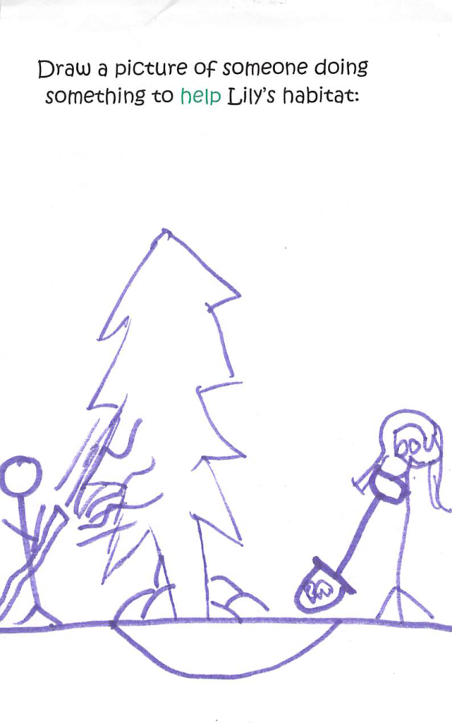
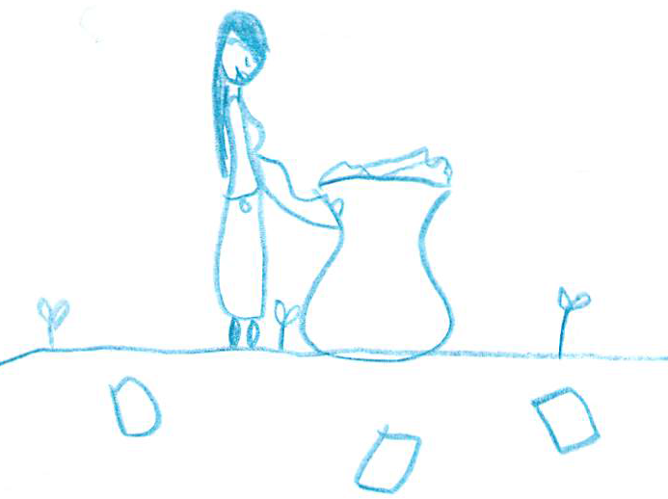
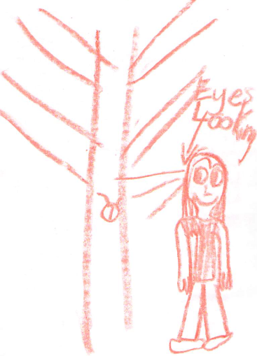
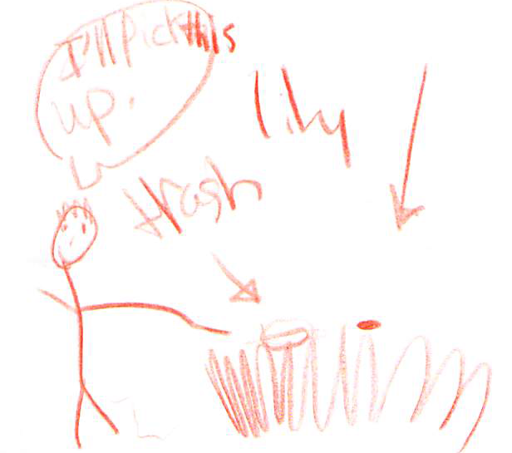
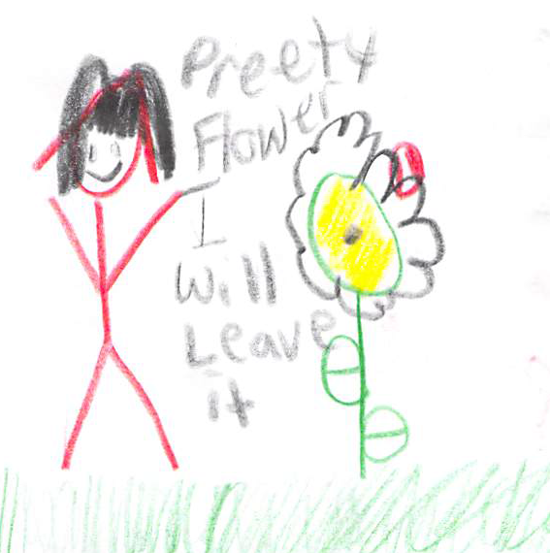
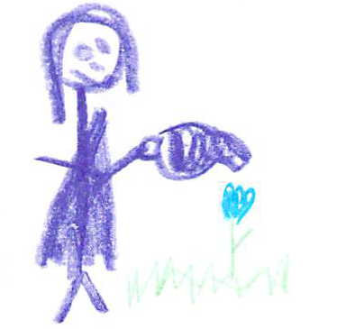
Sample Responses: “Draw a picture of someone doing something to HELP Lily’s habitat.”

Slide 44
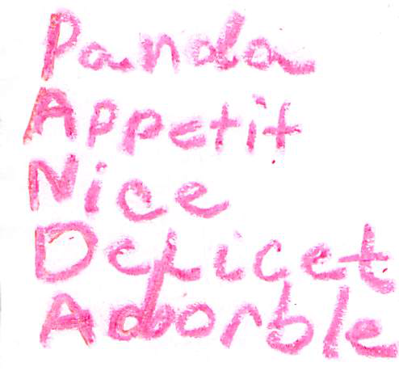
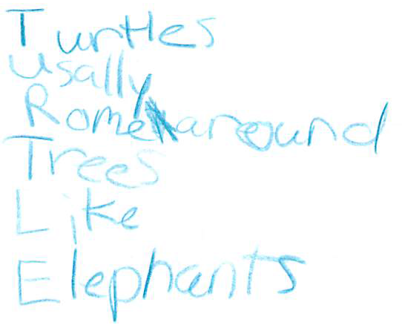
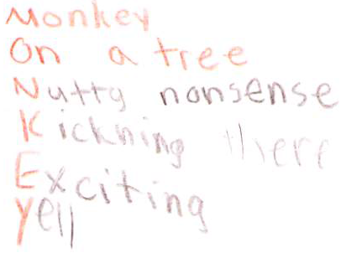
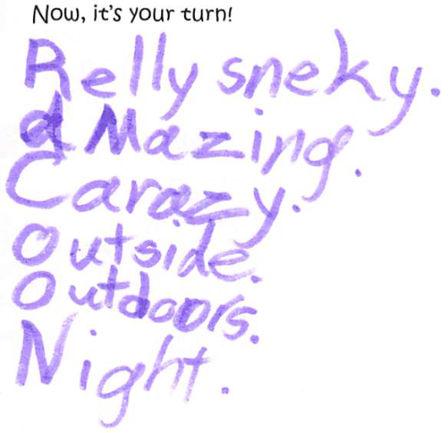
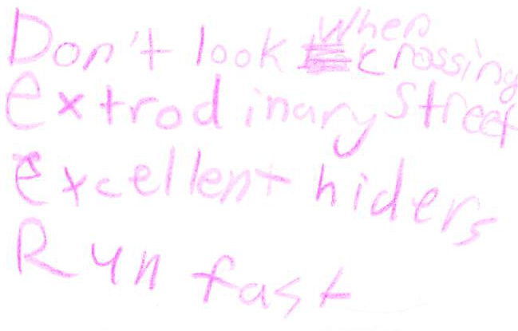
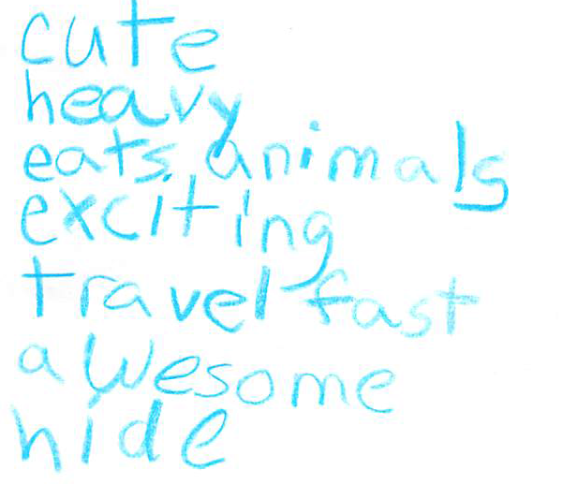
Sample Responses: Acrostic Poems

Slide 45
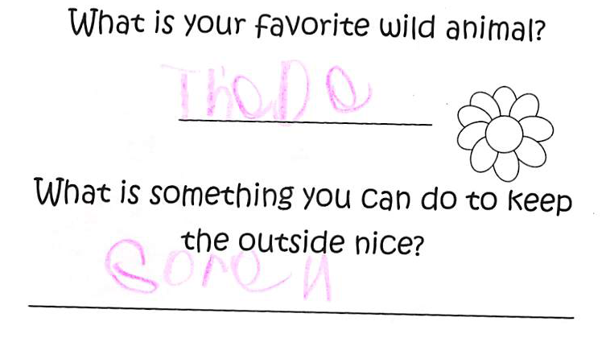
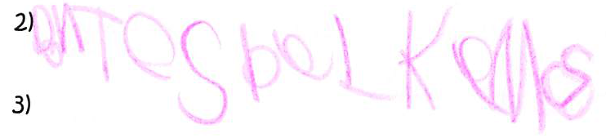
Sample responses we couldn’t decipher for the life of us
Something to do in Illinois to help the ocean:

Slide 46
What We’re Finding
How well each activity worked

Slide 47
What We’re Finding
How well each activity worked
Effects of combining them

Slide 48
What We’re Finding
Is the effort worth it?

Slide 49
What We’re Finding
Is the effort worth it?
Does it enhance the experience for kids?

Slide 50
What We’re Finding
Is the effort worth it?
Does it enhance the experience for kids?
Where do we go from here?

Slide 51
Questions and Discussion
Special Thanks:
April Buther Wennerstrom, Stacey Rice, Grace Keegan Massinello:
  Keep America Beautiful
Ben Lawhon: Leave No Trace International
Jen Randolph: Girl Scouts of Southern Illinois
Dan King, Jeremy Culpepper, Brian Joseph: Camp Ondessonk
Camp Ondessonk and Camp Cedar Point staff
Kelsey Ernst and Dusty Copple, research assistants
Theories
Notes:
Advance to next slide as questions begin

Slide 52
Supplemental Slides: We Who Really Own “Geek” & “Nerd”
Notes:
Duplicated at the end to reiterate

Slide 53
Useful Work By Smart People
Level of
Elaboration
Motivation
Ability

Slide 54
Message Phrasing Approach
Prescriptive
Positive phrasing
Acceptable
Less effective
Proscriptive
Negative phrasing
Less preferable
More effective
(Winters et al. 2007)
Notes:
Duplicated at the end to reiterate

Slide 55
Message Structuring
Descriptive
Explain what’s happening
Preferred by visitors
Less effective
Injunctive
Issue command
Less preferable to visitors
More effective
(Winter et al. 2000)
Notes:
Duplicated at the end to reiterate

Slide 56

Site Management
Notes:
Duplicated at the end to reiterate

Slide 57


The Data

