Slide 1
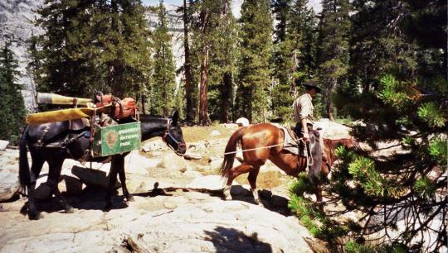
Trails That Last: Siting, Construction, and Maintenance
Logan-Park.org | Illinois Horse Fair

Slide 2
First, Thanks.
You, for joining us today
Please ask questions as we go, don’t wait
Sheryl King, Ph.D.
David Nobbe, Ph.D.
Emi Hayashi, D.V.M.

Slide 3
Who I Am
Southern Ohio
Xenia
Virginia Tech
SIU Forestry

Slide 4
Today’s Goal
Sensible trail work
Measure twice, cut once
Evidence-based techniques

Slide 5
Why We Do It
Safety
Quality experience
Resource protection
Get more people riding

Slide 6
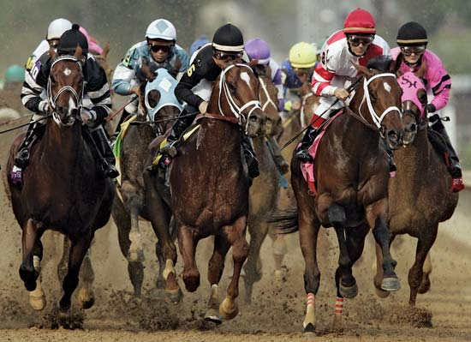

Slide 7
In racing, this is awesome.
From a trail maintenance perspective,
this is a complete disaster.

Slide 8
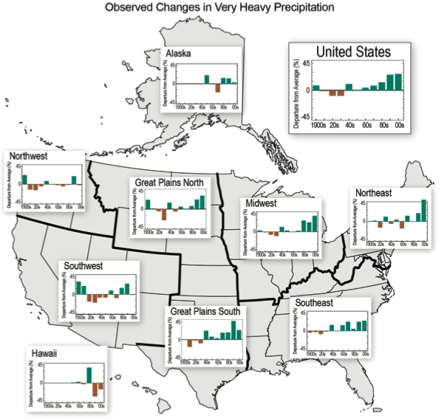
Why Trail Science Matters

Slide 9
So, A Good Trail--
Protects you
Protects horses
Protects resources
Interesting

Slide 10
Discussion – When Trails Fail You…
How do they fail you?
What are the most common problems that tick you off?

Slide 11
Prep: Measure Twice, Cut Once

Slide 12
Prep: Measure Twice, Cut Once
Tools
Rules
Tools
Time
Labor
Regulations
Land ownership
Liability exposure

Slide 13
Prep: Measure Twice, Cut Once
Tools
Power Equipment
Tools
Time
Labor
Tractor w/ scoop & blade or
Dingo

Slide 14
Prep: Measure Twice, Cut Once
Tools
Power Equipment
Tools
Time
Labor
Tractor w/ scoop & blade or
Dingo

Slide 15
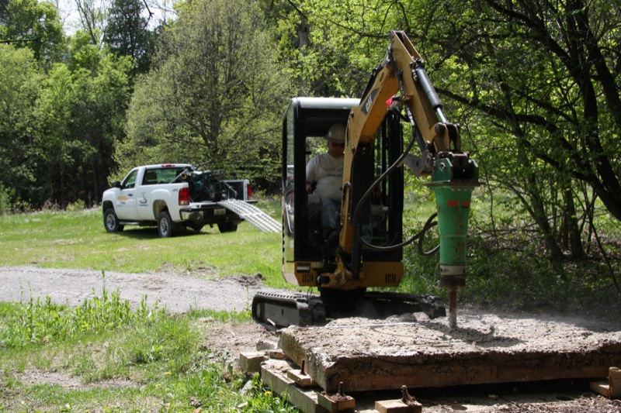
Prep: Measure Twice, Cut Once
Tools
Power Equipment
Tools
Time
Labor
Tractor w/ scoop & blade or
Other narrow-gauge mech

Slide 16
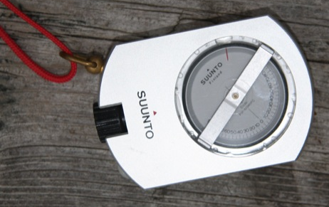
Prep: Measure Twice, Cut Once
Tools
Hand Equipment
Tools
Time
Labor
Clinometer

Slide 17
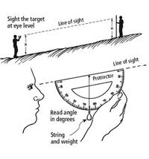
Prep: Measure Twice, Cut Once
Tools
Hand Equipment
Tools
Time
Labor
Clinometer
Image: extension.umn.edu

Slide 18
Prep: Measure Twice, Cut Once
Tools
Hand Equipment
Tools
Time
Labor
Clinometer
Never trust your eyeballs regarding slope!

Slide 19
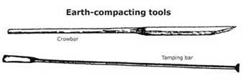
Prep: Measure Twice, Cut Once
Tools
Hand Equipment
Tools
Time
Labor
Rock bar
Image: fhwa.dot.gov

Slide 20
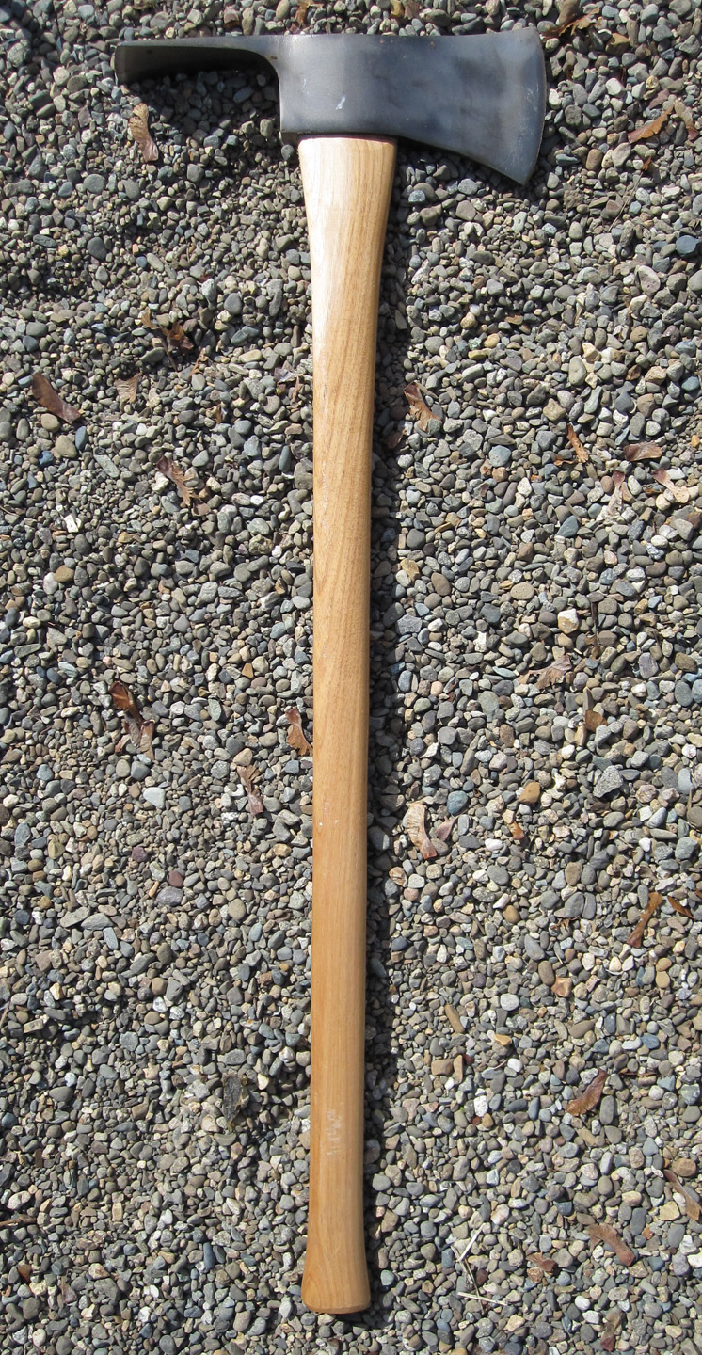
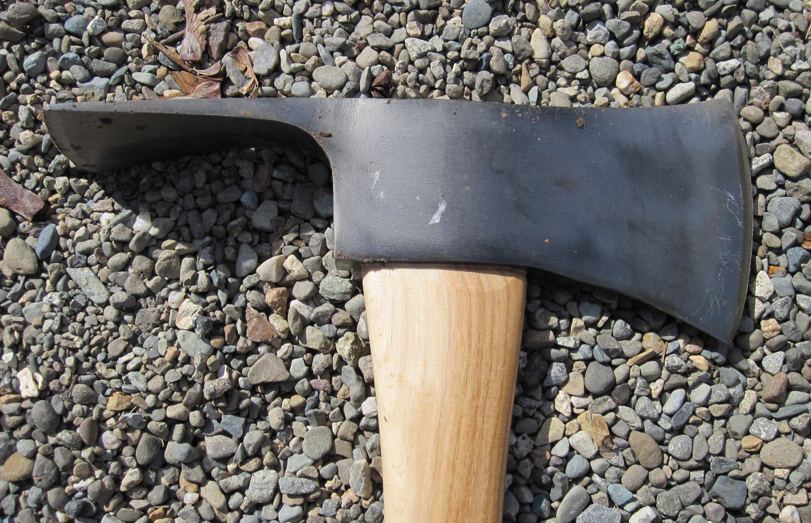
Prep: Measure Twice, Cut Once
Tools
Hand Equipment
Tools
Time
Labor
Pulaski
Images: dedavisart.wordpress.com

Slide 21
Prep: Measure Twice, Cut Once
Tools
Hand Equipment
Tools
Time
Labor
Arborist telescoping loppers
Keep you safely in the saddle
Image: atraes.com.au

Slide 22
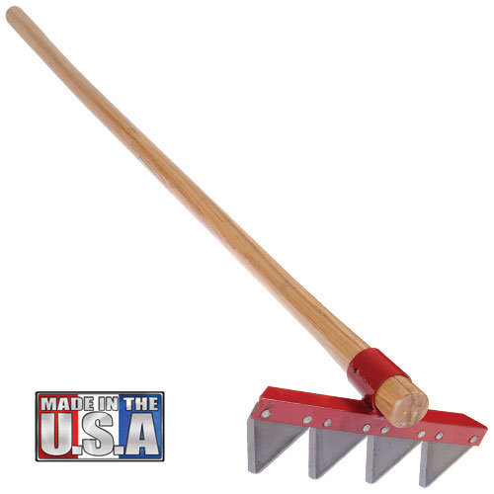
Prep: Measure Twice, Cut Once
Tools
Hand Equipment
Tools
Time
Labor
Council rake
Image: amleo.com

Slide 23
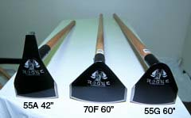
Prep: Measure Twice, Cut Once
Tools
Hand Equipment
Tools
Time
Labor
Rogue hoe
Image: thestgeorgeco.com

Slide 24
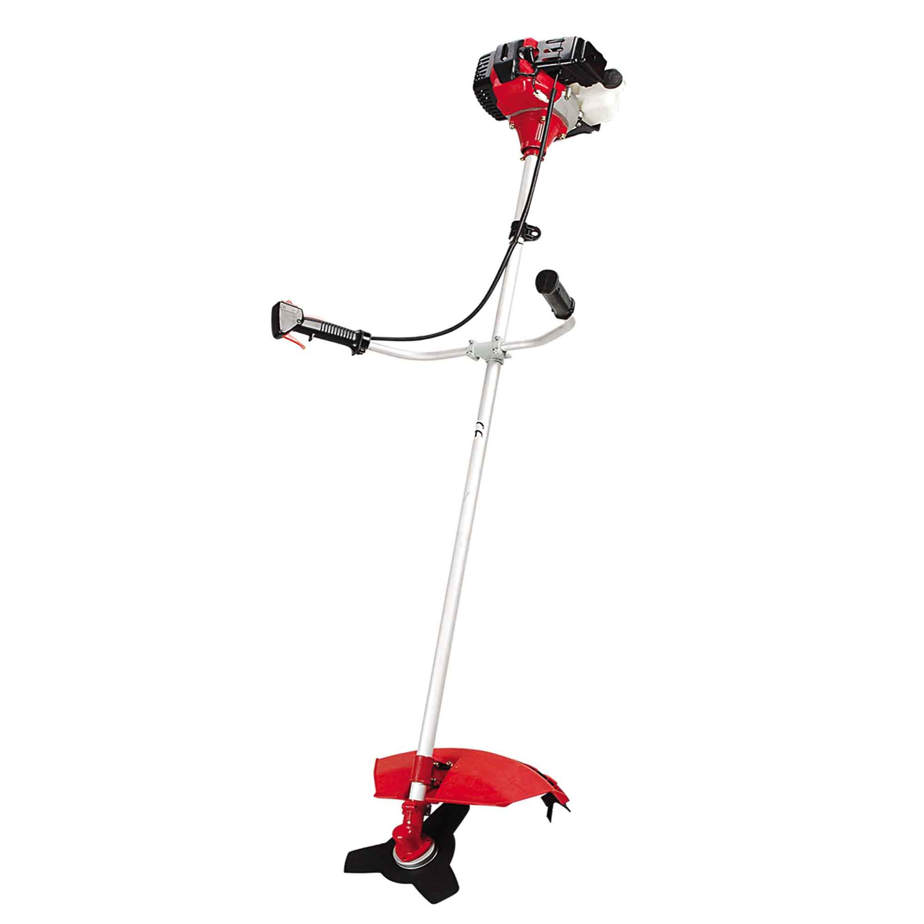
Prep: Measure Twice, Cut Once
Tools
Hand Equipment
Tools
Time
Labor
Brushcutter
Image: freewtc.com

Slide 25
Prep: Measure Twice, Cut Once
Tools
Hand Equipment
Tools
Time
Labor
Stump grubber

Slide 26
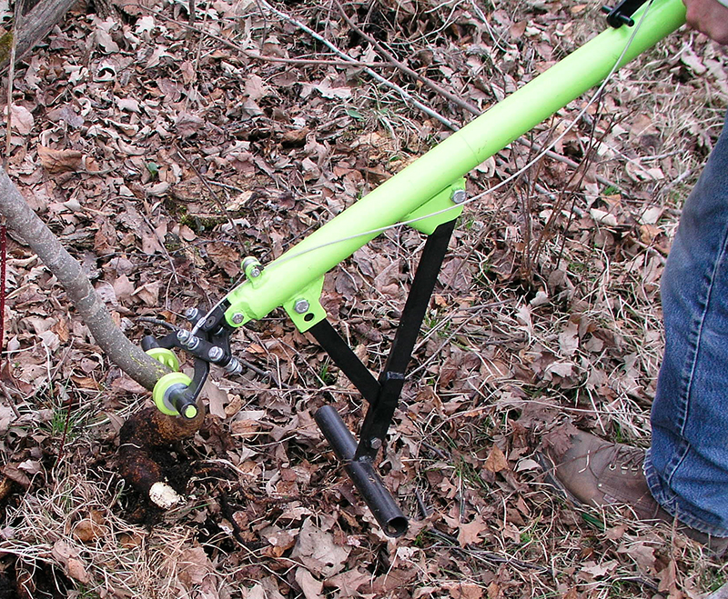

Slide 27
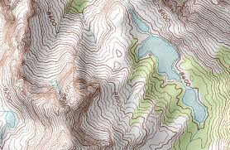
Siting (designing the trail)

Slide 28
Siting: Landform Position
Ridge
Valley
Sidehill
Best vistas
Most exposed
Fastest damaged (weather)
Hard to drain
Much braiding

Slide 29
Siting: Landform Position
Ridge
Valley
Sidehill
Few vistas
Least exposed
Fastest damaged (mud)
Impossible to drain
Standing water health problems
Much braiding

Slide 30
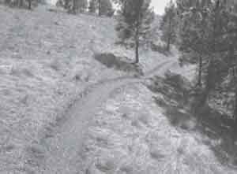
Siting: Landform Position
Ridge
Valley
Sidehill
Moderately exposed
Good vistas
Easy to drain
Minimal braiding
“Contour trail”
Rolling grade dips
Image: fs.fed.us

Slide 31
Siting: Set the Centerline
Slope
TSA
Substrate
Vegetation
Use level and type
Water
Sight lines
Landform slope
Higher is better

Slide 32
Siting: Set the Centerline
Slope
TSA
Substrate
Vegetation
Use level and type
Water
Sight lines
Landform slope
Trail slope
Lower is better
5% to 8% max
Less than you think!

Slide 33
Siting: Set the Centerline
Slope
TSA
Substrate
Vegetation
Use level and type
Water
Sight lines
Landform slope
Trail slope
Lower is better
5% to 8% max
Less than you think!
Contour trail

Slide 34
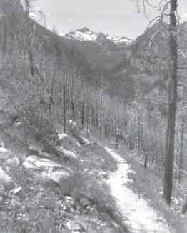
Contour Trail Looks Like:

Slide 35
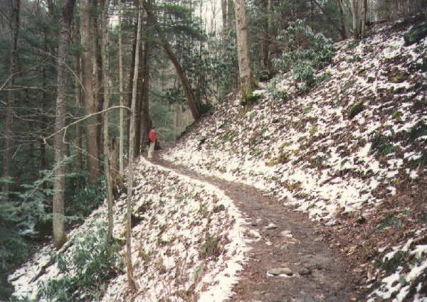
Contour Trail Looks Like:

Slide 36
Siting: Set the Centerline
Slope
TSA
Substrate
Vegetation
Use level and type
Water
Sight lines
Old way: Half rule
“trail slope always less
than half landform slope”

Slide 37
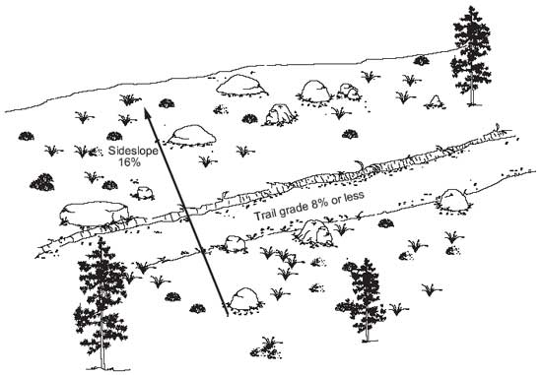
Image: fhwa.gov

Slide 38
Siting: Set the Centerline
Slope
TSA
Substrate
Vegetation
Use level and type
Water
Sight lines
Trail – Slope Alignment Angle
(0 – 90°)
Higher is better
Hill’s facing (“aspect”)
Trail’s direction
65 to 90° ideal

Slide 39
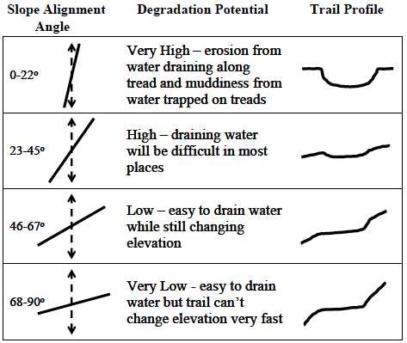

Slide 40
Siting: Set the Centerline
Slope
TSA
Substrate
Vegetation
Use level and type
Water
Sight lines
Mineral Soil:
Coarse
Sand
Silt
Clay

Slide 41
Siting: Set the Centerline
Slope
TSA
Substrate
Vegetation
Use level and type
Water
Sight lines
In loess, remove down to mineral soil
Add mixed fines
Not graded

Slide 42
Siting: Set the Centerline
Slope
TSA
Substrate
Vegetation
Use level and type
Water
Sight lines
Trees
Shield from rain
Keep poor-draining trails wet

Slide 43
Siting: Set the Centerline
Slope
TSA
Substrate
Vegetation
Use level and type
Water
Sight lines
Trees
Shield from rain
Keep poor-draining trails wet
Grasses
Resistant and resilient
Browse, ticks

Slide 44
Siting: Set the Centerline
Slope
TSA
Substrate
Vegetation
Use level and type
Water
Sight lines
Do you have to share the trail?

Slide 45
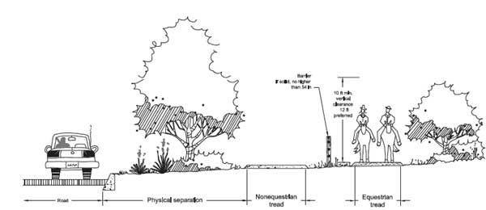
Safer Shared Trails

Slide 46
Motorized recreation

Slide 47
Physical buffer
Motorized recreation

Slide 48
Physical buffer
Motorized recreation, road cyclists
Hikers and MTB bikers

Slide 49
Physical buffer
Motorized recreation, road cyclists
Hikers and MTB bikers
See-through fence, below 54 inches

Slide 50
Pro tip: Use fire to manage for wildlife, Use well-planned trail as fire line

Slide 51
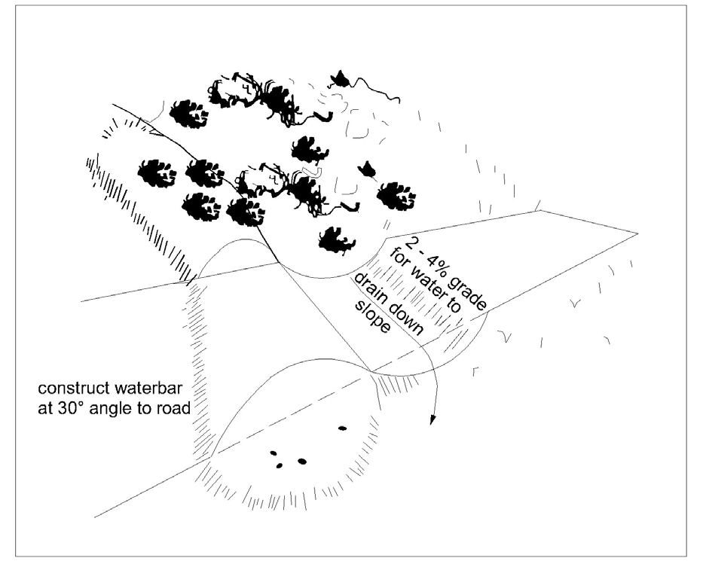
Siting: Set the Centerline
Slope
TSA
Substrate
Vegetation
Use level and type
Water
Sight lines
High maintenance trails look like this:
Image: elibrary.dep.state.pa.us

Slide 52
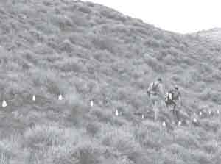
Siting: Set the Centerline
Slope
TSA
Substrate
Vegetation
Use level and type
Water
Sight lines
Low maintenance trails look like this:
Image: fhwa.dot.gov

Slide 53
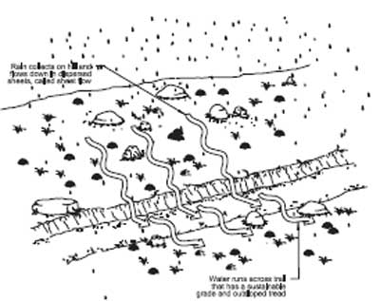
Siting: Set the Centerline
Low maintenance trails look like this:
Slope
TSA
Substrate
Vegetation
Use level and type
Water
Sight lines
Image: fhwa.dot.gov

Slide 54
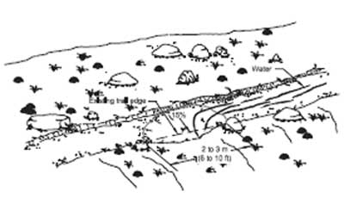
Siting: Set the Centerline
Low maintenance trails look like this:
Slope
TSA
Substrate
Vegetation
Use level and type
Water
Sight lines
Image: fhwa.dot.gov

Slide 55
Siting: Set the Centerline
Trails parallel to streams become streams
Slope
TSA
Substrate
Vegetation
Use level and type
Water
Sight lines
50 – 150 ft. buffer to waterways based on slope

Slide 56
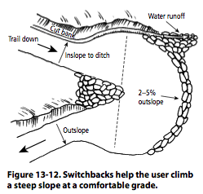
Siting: Set the Centerline
Slope
TSA
Substrate
Vegetation
Use level and type
Water
Sight lines
Not so good:
Image: woodlandstewardship.org

Slide 57
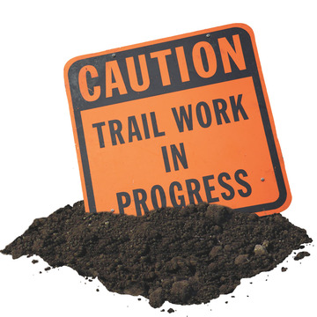
Trail Construction
Image: chattanoogahiking.com

Slide 58
Safety First and Last
The only good trail work day is one without spurting head wounds
Know your “kill radius”

Slide 59
Trail Construction
Flag
Cut
Subsurface
Surface
Vegetation

Slide 60
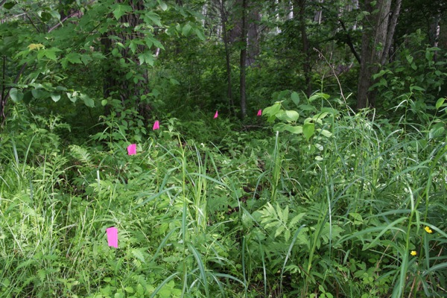
Trail Construction
Flag
Cut
Subsurface
Surface
Vegetation

Slide 61
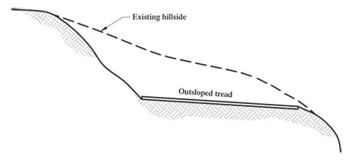
Trail Construction
Flag
Cut
Subsurface
Surface
Vegetation
This
2 – 5% outslope
Images: fs.fed.us

Slide 62
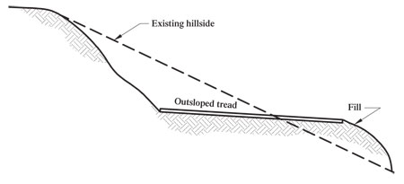
Trail Construction
Flag
Cut
Subsurface
Surface
Vegetation
This
Not this
Images: fs.fed.us

Slide 63
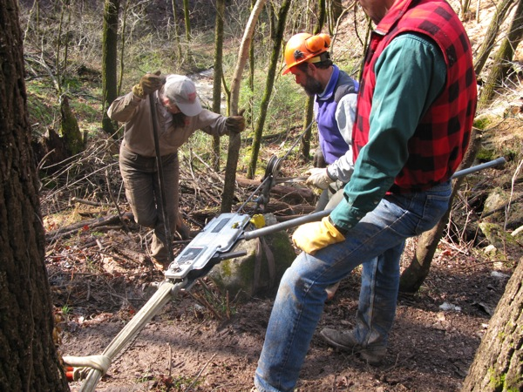
Trail Construction
Flag
Cut
Subsurface
Surface
Vegetation
High-lining icebergs in/out

Slide 64
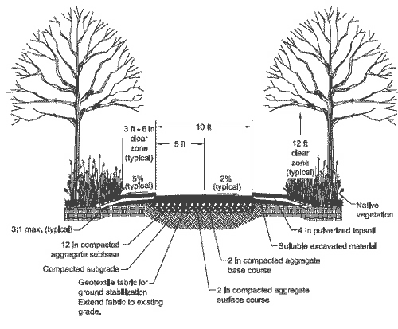
Trail Construction
Flag
Cut
Subsurface
Surface
Vegetation
Image: fhwa.dot.gov

Slide 65
Compacted subgrade
(mineral soil)

Slide 66
12 inches compacted aggregate subbase
Compacted subgrade
(mineral soil)

Slide 67
2 inches compacted aggregate base course
12 inches compacted aggregate subbase
Compacted subgrade
(mineral soil)

Slide 68
2 inches compacted aggregate surface course
2 inches compacted aggregate base course
12 inches compacted aggregate subbase
Compacted subgrade
(mineral soil)

Slide 69
2 inches compacted aggregate surface course
2 inches compacted aggregate base course
Have a friend with a dump truck (16 cubic yards) or a souped-up tractor + hauling trailer
12 inches compacted aggregate subbase
Compacted subgrade
(mineral soil)

Slide 70
Trail Construction
Flag
Cut
Subsurface
Surface
Vegetation
Aggressively clear for safety and sight lines, but no more

Slide 71
Trail Construction
Flag
Cut
Subsurface
Surface
Vegetation
Aggressively clear for safety and sight lines, but no more
Leave as many trees intact as possible

Slide 72
Trail Construction
Flag
Cut
Subsurface
Surface
Vegetation
Aggressively clear for safety and sight lines, but no more
Leave as many trees intact as possible
Cross large trees on the uphill side

Slide 73
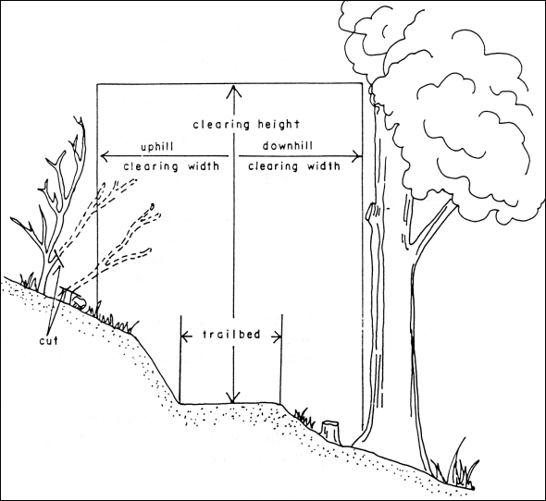
Image: for.gov.bc.ca

Slide 74
10 ft. minimum, 12 ft. safer
Image: for.gov.bc.ca

Slide 75
Limbing

Slide 76
Limbing
Brushing

Slide 77
Stump grubbing
Limbing
Brushing

Slide 78
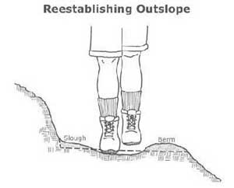
Trail Maintenance
Late winter
As needed
Following storms
De-berming
Image: fhwa.dot.gov

Slide 79
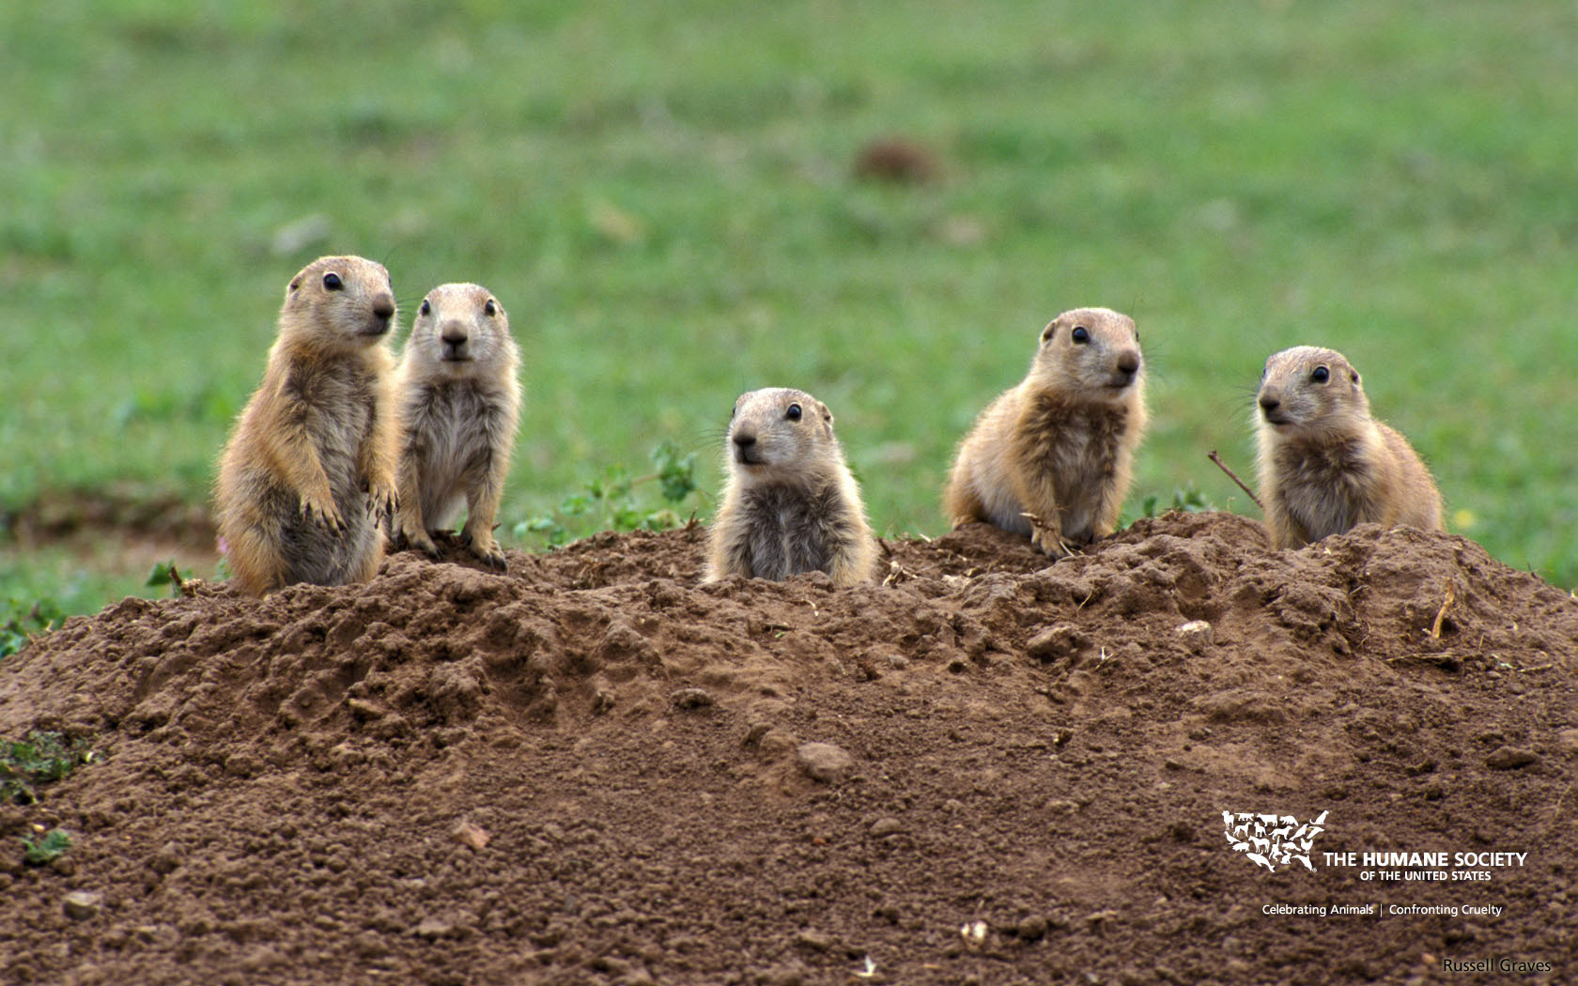
Trail Maintenance
Late winter
As needed
Following storms
De-berming
Removing pest wildlife
Image: Humane Society

Slide 80
Trail Maintenance
Late winter
As needed
Following storms
De-berming
Removing pest wildlife
Cut back vegetation

Slide 81
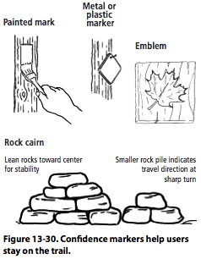
Trail Maintenance
Late winter
As needed
Following storms
De-berming
Removing pest wildlife
Cut back vegetation
Reassurance markers
Image: woodlandsteward.com

Slide 82
Trail Maintenance
Late winter
As needed
Following storms
De-berming
Removing pest wildlife
Cut back vegetation
Reassurance markers
Wayfinding

Slide 83
Trail Maintenance
Late winter
As needed
Following storms
De-berming
Removing pest wildlife
Cut back vegetation
Reassurance markers
Wayfinding
Closing visitor-created trails

Slide 85
Trail Maintenance
Late winter
As needed
Following storms
De-berming
Removing pest wildlife
Cut back vegetation
Reassurance markers
Wayfinding
Closing visitor-created trails
Mitigating standing water

Slide 86
Trail Maintenance
Late winter
As needed
Following storms
De-berming
Removing pest wildlife
Cut back vegetation
Reassurance markers
Wayfinding
Closing visitor-created trails
Mitigating standing water
Spook hazards

Slide 87
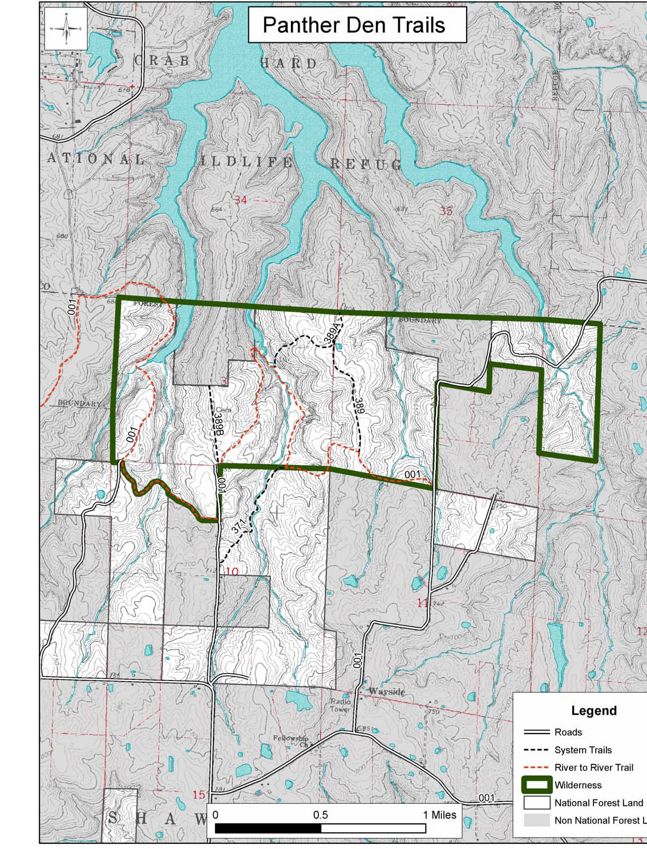
Success Stories – Shawnee National Forest
7 federally designated wilderness areas near
Image: fs.fed.us

Slide 88
Success Stories – Shawnee National Forest
7 federally designated wilderness areas near
10 riding areas
Image: blogspot.com

Slide 89
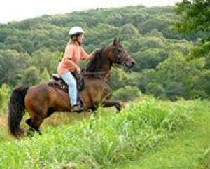
Success Stories – Shawnee National Forest
7 federally designated wilderness areas near
10 riding areas
Top-ranked trail volunteer coordinator in the country
Image: thesouthern.com

Slide 90
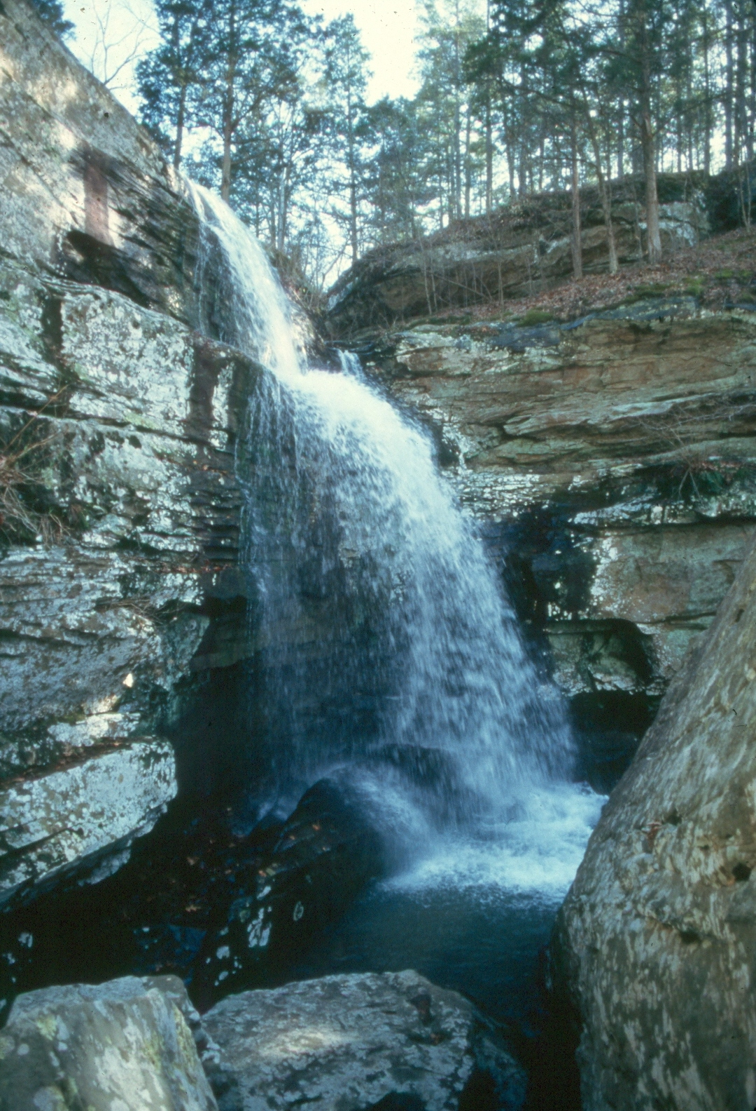
Success Stories – Shawnee National Forest
7 federally designated wilderness areas
10 riding areas
Top-ranked trail volunteer coordinator in the country
Multiple horse-friendly campgrounds nearby
Image: fs.usda.gov

Slide 91
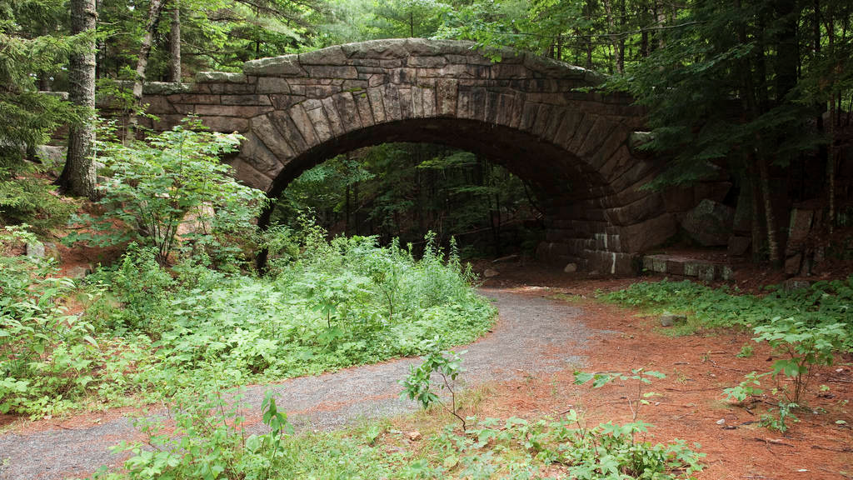
Success Stories – Acadia National Park
Image: usparks.about.com

Slide 92
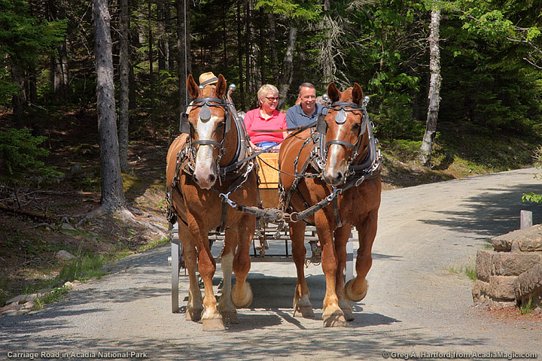
Image: acadiamagic.com

Slide 93
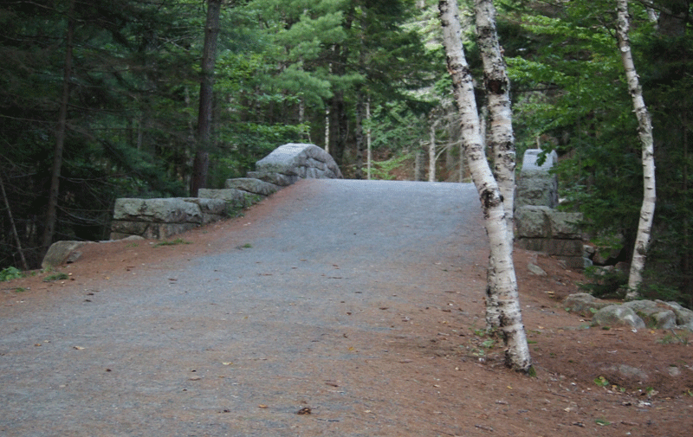
Success Stories – Acadia National Park
Image: exploringtheusbyrv.com

Slide 94
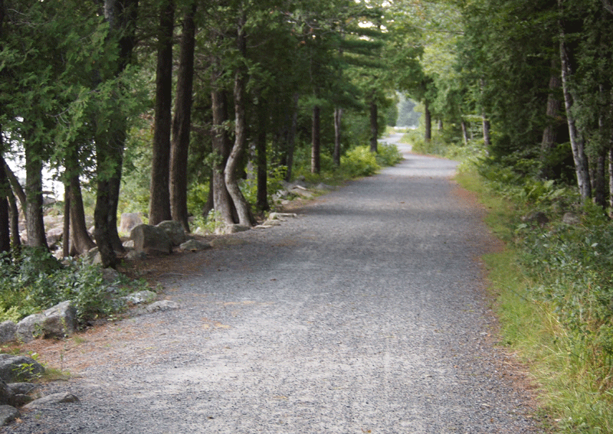
Image: exploringtheusbyrv.com

Slide 95
Other Success Stories?
Where have you been that rode really well?

Slide 96
Handy Resources
Equestrian Trail Design Guidebook
links.logan-park.org/index.php/?i=16
Professional Trail Builders Association
ptba.org
U.S.F.S. Trail Construction Manual
links.logan-park.org/index.php/?i=17
Shawnee Trail Conservancy
shawneetrailconservancy.com
Equestrian Trail BMPs
http://links.logan-park.org/index.php/?i=19

Slide 97
Thank You Again
Questions and comments?

