Slide 1
Topics in Australian Recreation

Slide 2
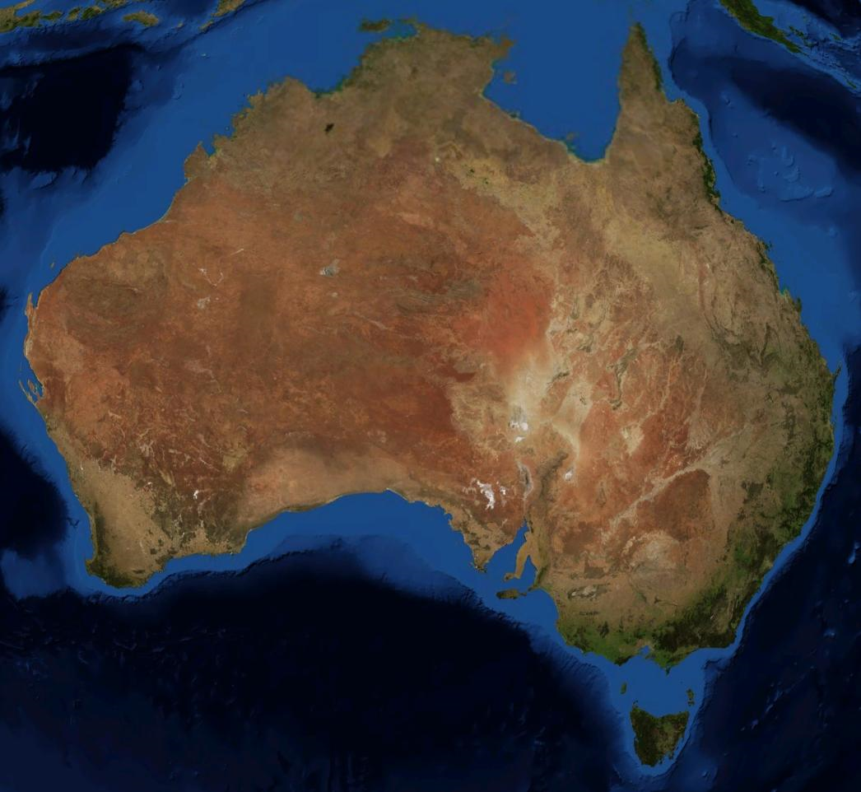

Slide 3
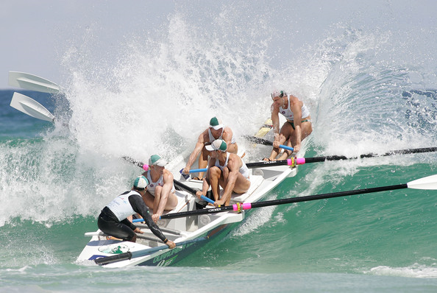
Recreation in Australia
Culture of the outdoors
No formal federal wilderness
Nascent Scenic Rivers program (Stein, Stein, and Nix 2001)
Conservation first, recreation second

Slide 4
Recreation in Australia
Large tracts
Tasmanian Wilderness World Heritage Area
3.4 M acres
Approx. 20% of land area
245 K bushwalkers, 20 K overnight
7% growth
(Bennett, Kriwoken, and Fallon 2002)

Slide 5
Recreation in Australia
Historically hostile legislation
Growing recreation demand vs. limited public involvement
Management policy in limbo (Buckley 2000)

Slide 6
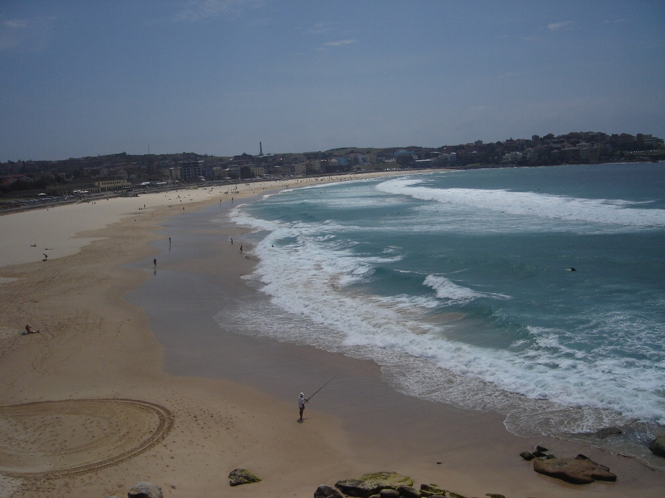

Slide 7
Beaches vs. Sharks
Permanent shark nets off Australia’s “Gold Coast” resort beaches kill dolphins, sharks, and other marine life (Liddle 1997)
Nets installed to protect tourism industry from any hint of shark danger in the area
At Sydney Beach, nets first installed in 1937; 1500 sharks caught and killed in first 17 months (Coppleson 1992)

Slide 8
Beaches vs. Sharks
In 1947, only 95 sharks caught (Reid and Krogh 1992)
Steady size reduction into 1990s (Reid and Krogh 1992)
Slow recovery rates; sharks mature slowly and birth few offspring (Walker 1993)
Between 1962 – 1988, southern Queensland nets bycatch: 500 cetaceans (dolphins), 3500 marine turtles, 10000 batoids (rays)

Slide 9
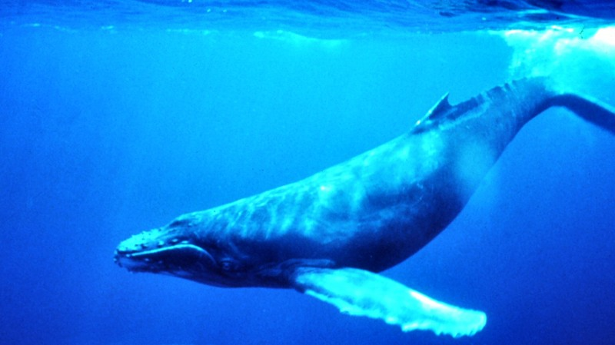
Humpback Whale Acoustic Disturbance
Present in early spring, eastern shore
Alert distance of 150m
Boating
Overflights

Slide 10
Nonnative Trout for Fly-Fishing etc.
Species | Common Name
Salmo trutta | Brown trout
Salmo gairdneri | Rainbow trout
Salvelinus fontinalis | Brook trout
Oncorhynchus tshawytscha | Chinook salmon
Salmo salar | Atlantic salmon
Perca fluviatilis | European perch
Cyprinus carpio | European carp
Tinca tinca | Tench
Rutilus rutilus | Roach
(Arthington 1989)
Notes:
Stringent water quality controls are being passed in Australia to support sensitive sport trout
Competing with local species

Slide 11
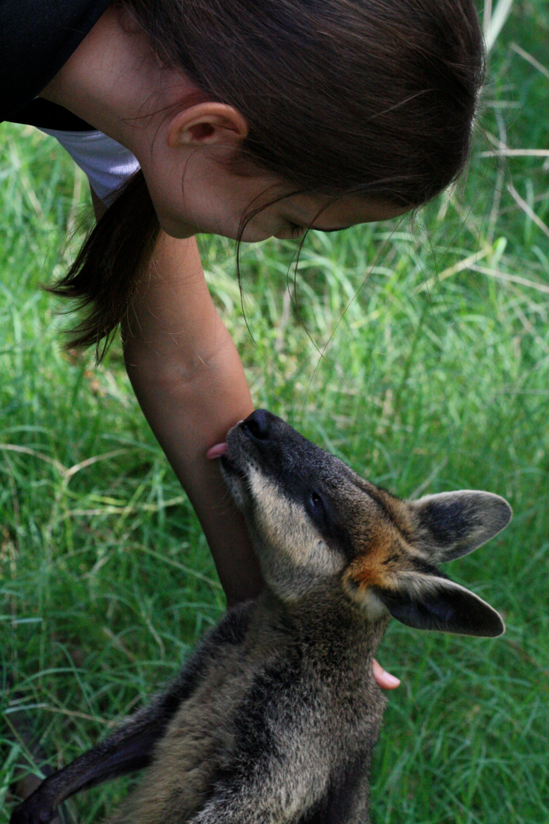
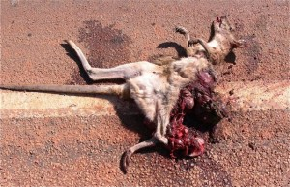
Marsupials
130 spp
Road kills
Swamp wallabies (wallabia bicolor)
Kangaroo
(macropus giganteus)
Rapid turnover rate
Warning signage

Slide 12
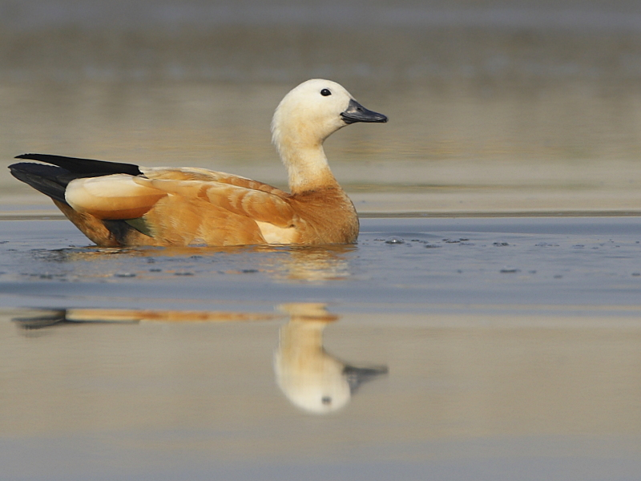
Ruddy Shelducks
(tadorna ferruginea)
Model powerboats
No displacement
Sheltering behaviors

Slide 13
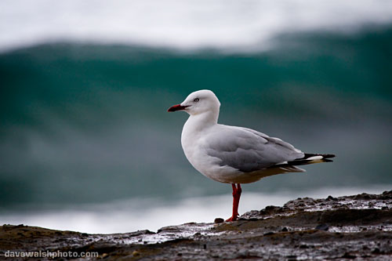
Silver Gulls
(larus novaehallandiae)
Southern Australia picnic and barbecue sites
Food scavenging

Slide 14
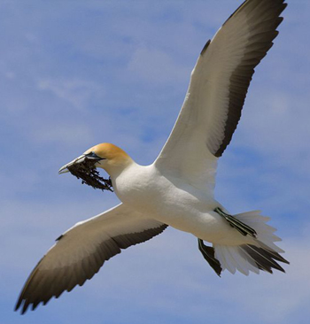
Australian Gannets
(morus serrator)
Population decline
Cat Island, Victoria
Human predation and vandalism (Harris and Norman 1981)
Widespread problem

Slide 15
Passerines Generally
Bird species composition change with habitat modifications at roadsides
(Arnold and Wheeldenburg 1990)

Slide 16
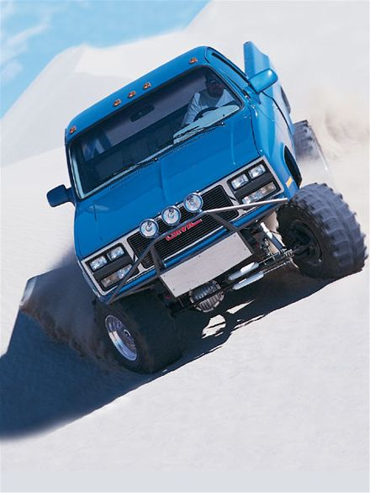
Dune Soil Loss
Coorong Dune and Lake Complex, South Australia
ORV use accelerating dune advance
Vegetated vs. non-vegetated dunes
Reflections on drive for solitude → impact expansion
(Gilbertson 1983)

Slide 17
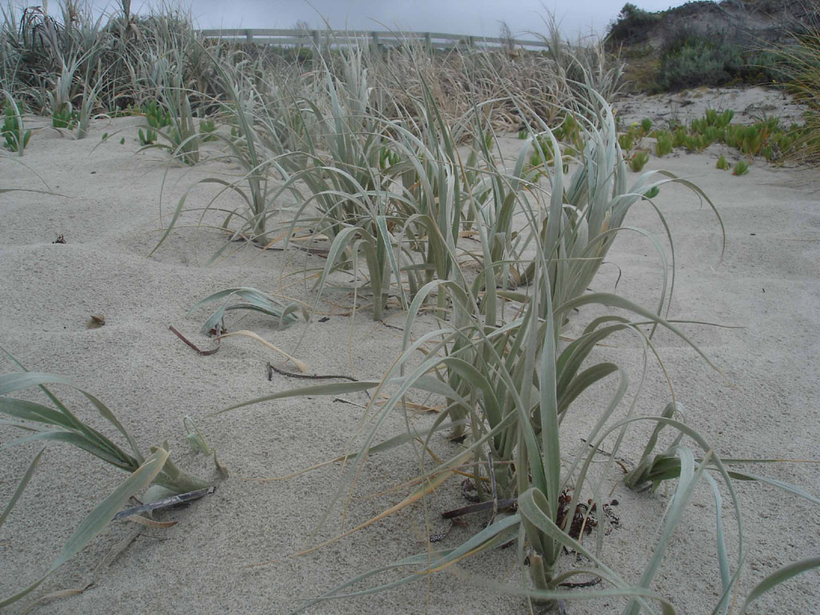
Dune Soil Loss
Spinifex grass (spinifex hirsutus)
(Liddle 1997)

Slide 18
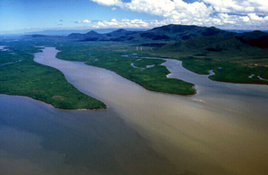
Soil Transport
Crooked and Wongungarra Rivers, Victoria, Australia
ORV river crossings
100 passes = 2.8 g/m2*month
400 passes = 3.25 g/m2*month
(Brown 1989)

Slide 19
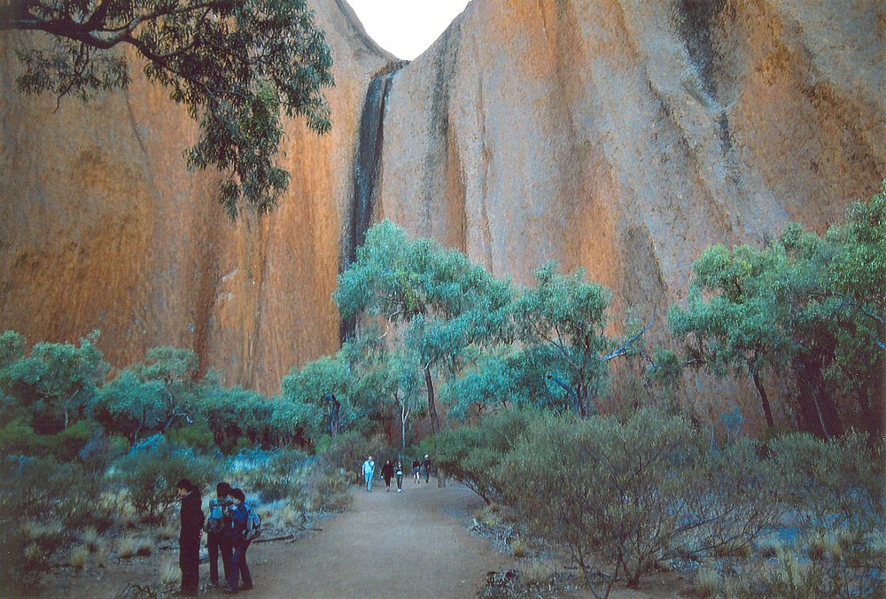
Vegetation Cover Loss
Brisbane Forest Park
Subtropical rainforest clearing
53% - 4% exposure gradient, 1.25m
Dry, open eucalyptus forest
12 passes → 50% loss
(Bluhdorn 1985)

Slide 20
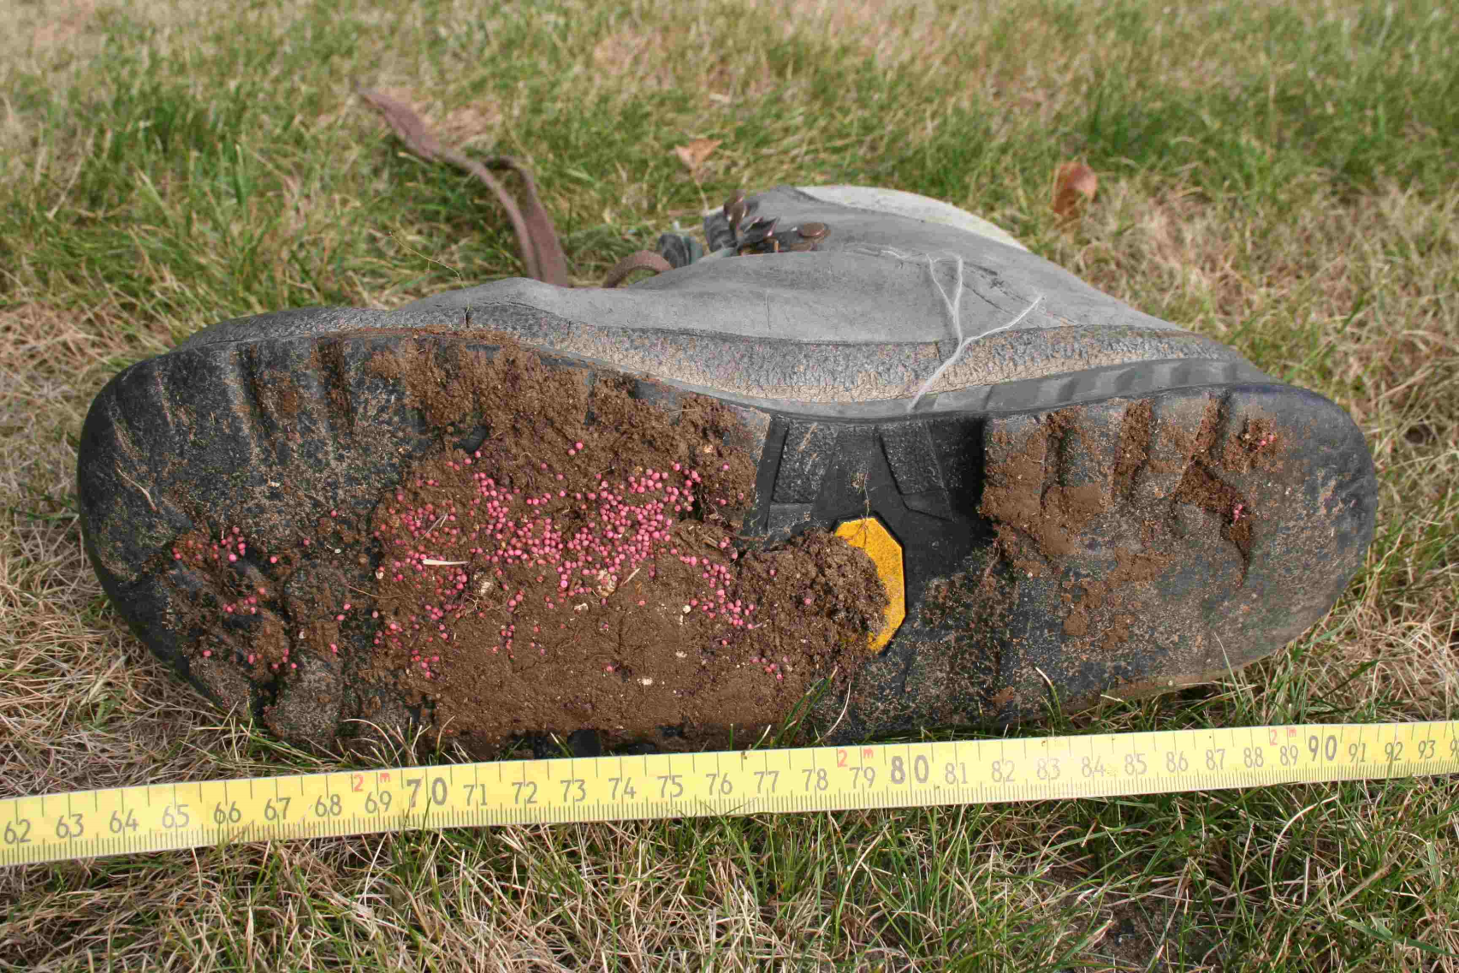
Vegetation Exotics
Kakadu National Park
Visitor vehicles vacuum-sampled across 7 months(Lonsdale and Lane 1992)
954/1505 propagules exotic, 84 species

Slide 21
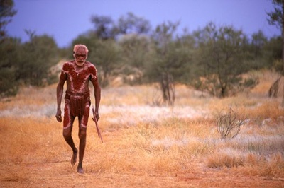
Management Responses at Tasmania WHA
Use type
Shift to low impact behaviors within use
Moving use to durable sites
Constrict use in busy areas
Disperse use into underutilized areas
Aboriginal stakeholders

